Slide 1
Seismicity TG Report
TG Activities as of August 2017

Slide 2
Updated Hazard Calculations for SW BC

Slide 3
Item 5.2.1
Update catalogue to at least end 2015

Slide 4
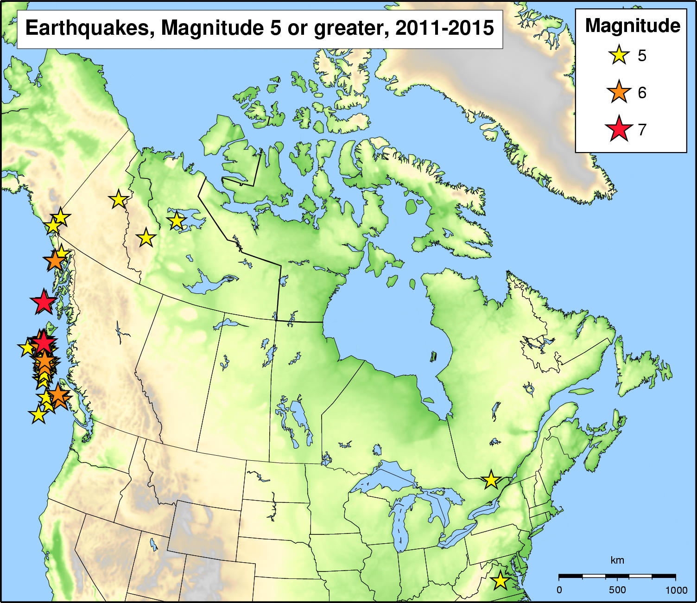

Slide 5
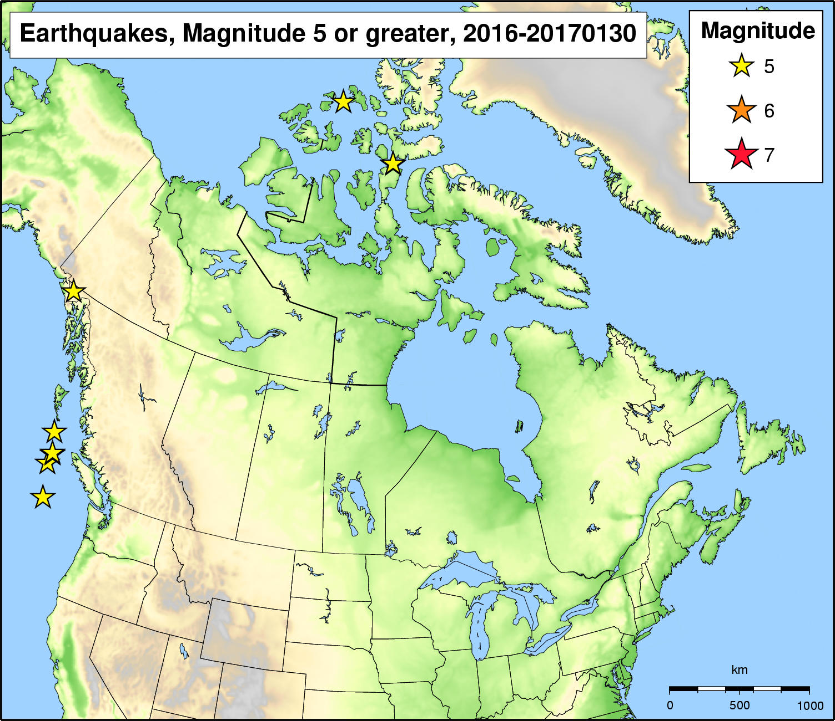

Slide 6
Opportunities for future catalogue improvements
Yenier (2017) noted that GSC ML magnitudes were likely overestimated due to the use of Californian magnitude relations (i.e., Richter )
May be a need to remediate catalogue magnitudes for future hazard assessments
After Yenier (2017)

Slide 7
Item 5.2.2: Add catalogue declustering
Have applied the Gardner & Knopoff declustering algorithm as implemented in the OQ Hazard Modeller’s Toolkit
Intended to remove “dependent events”
Calculated magnitude-frequency statistics for all zones based on non-declustered and non-declustered catalogues
Zone-specific results are here:
Non-declusterd: https://github.com/treviallen/2020_gsc_nshm/blob/master/sources/area_sources/2020_H_model/full_catalogue/2020_H_model_MFD.full.MERGE.pdf
Declusterd: https://github.com/treviallen/2020_gsc_nshm/blob/master/sources/area_sources/2020_H_model/declustered/2020_H_model_MFD.decl.MERGE.pdf
Note: some b-values and b-value uncertainties should be “fixed”
Consider grouping zones by geologic domains to ensure more robust statistics

Slide 8
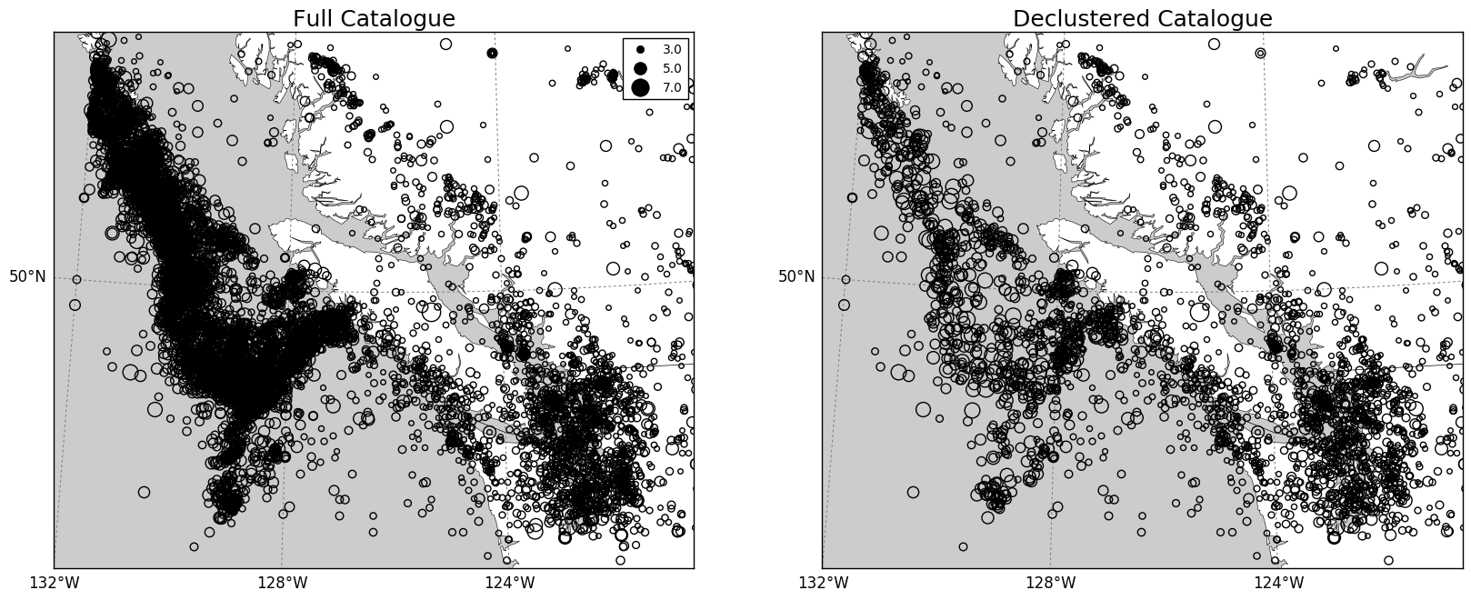
Declustering: Southwestern BC

Slide 9
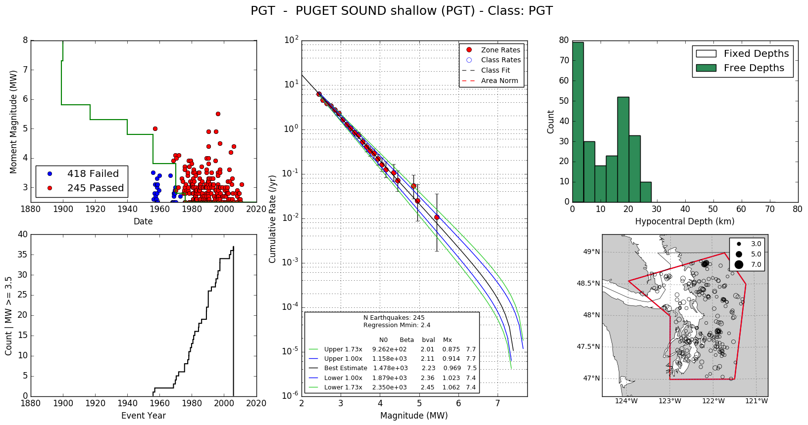
Non-declusterd Catalogue

Slide 10
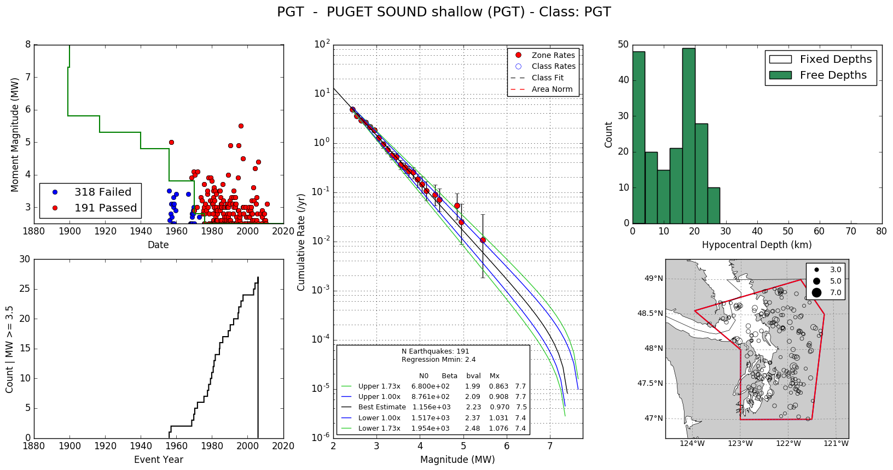
Declusterd Catalogue

Slide 11
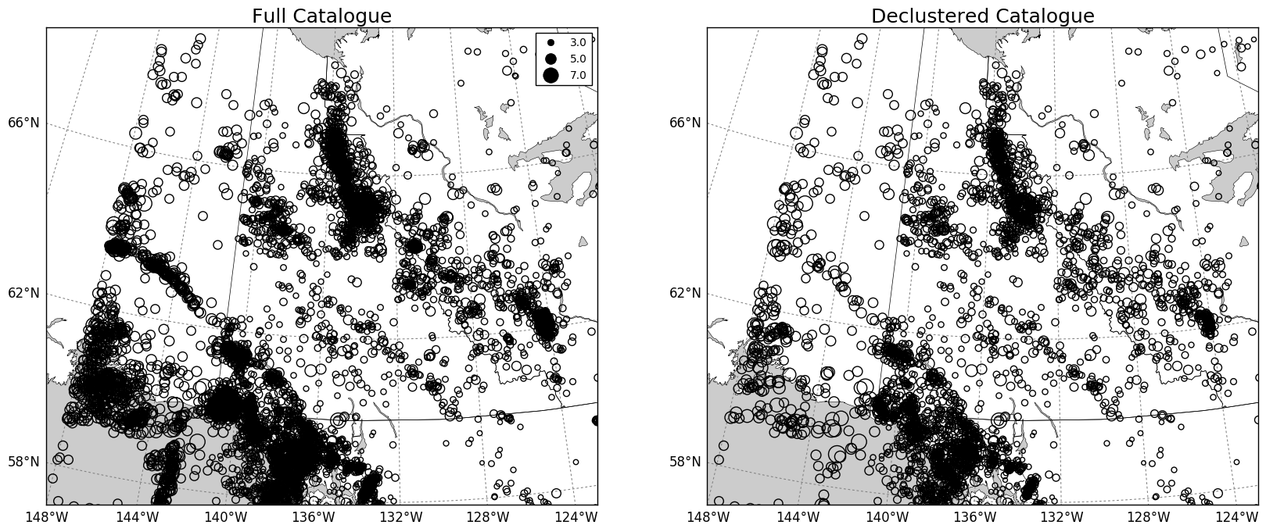
Declustering: Western Arctic

Slide 12
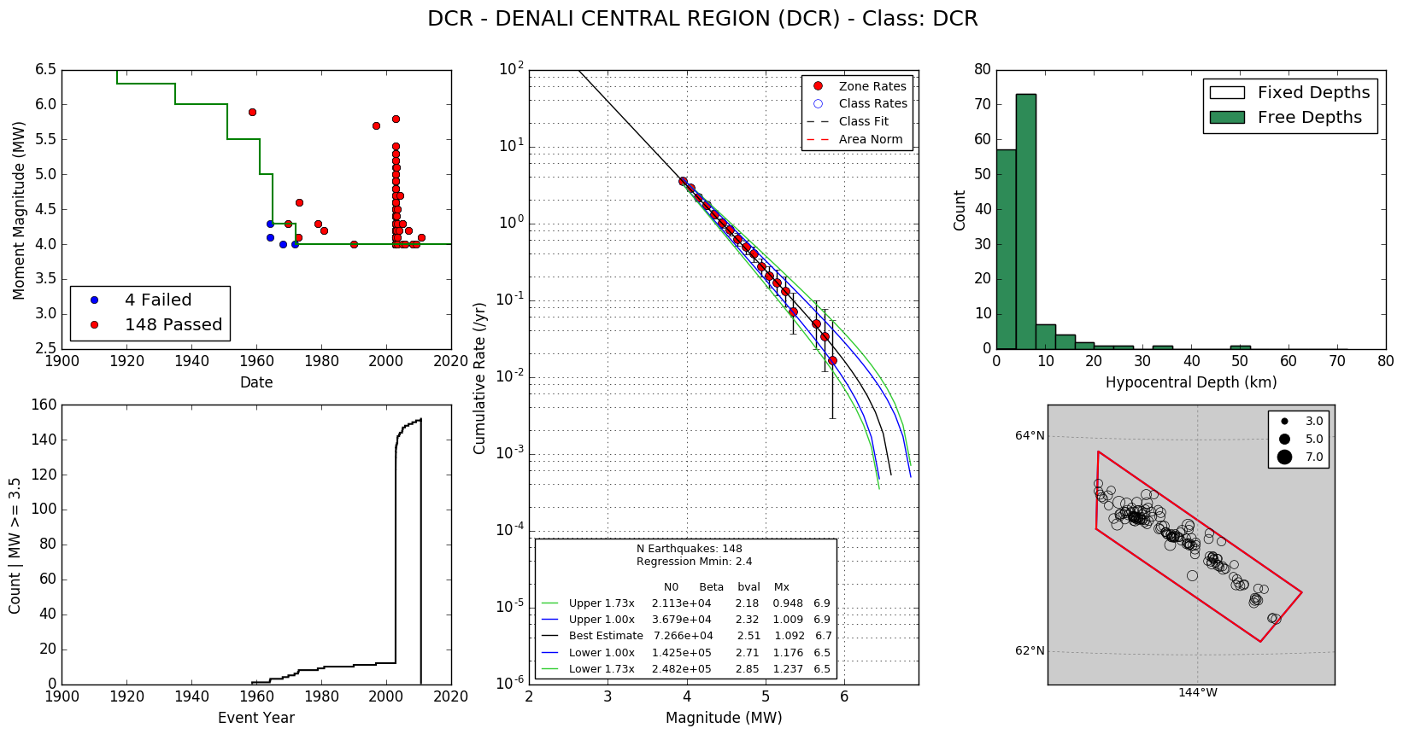
Non-declusterd Catalogue

Slide 13
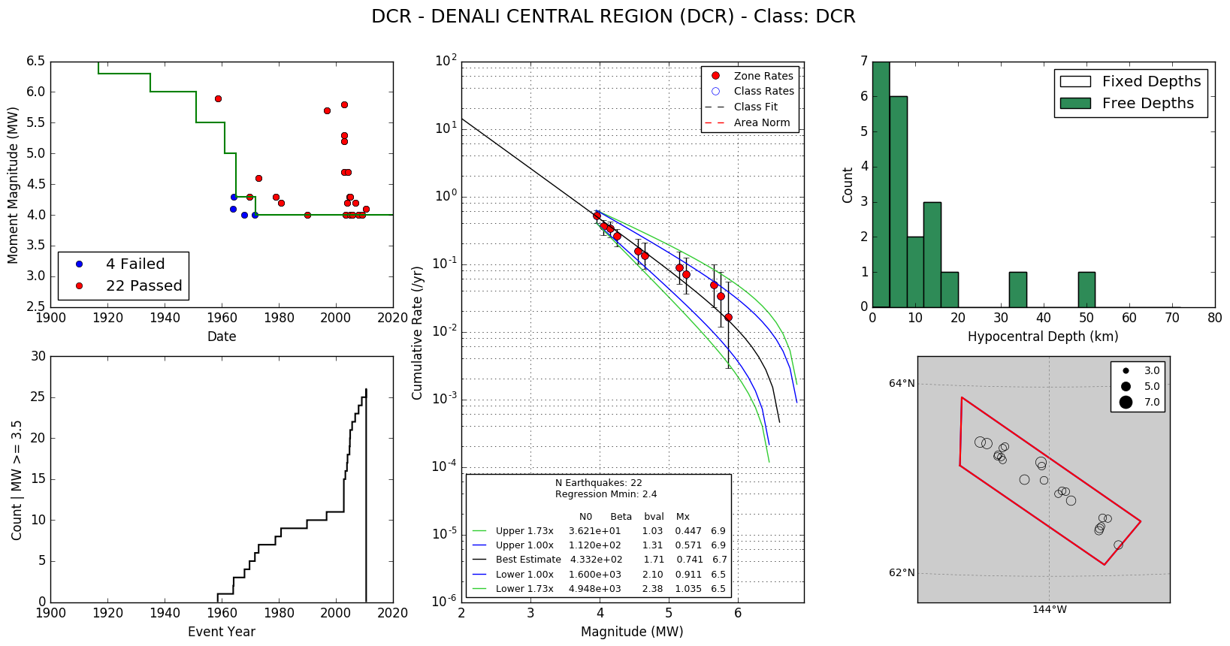
Declusterd Catalogue

Slide 14
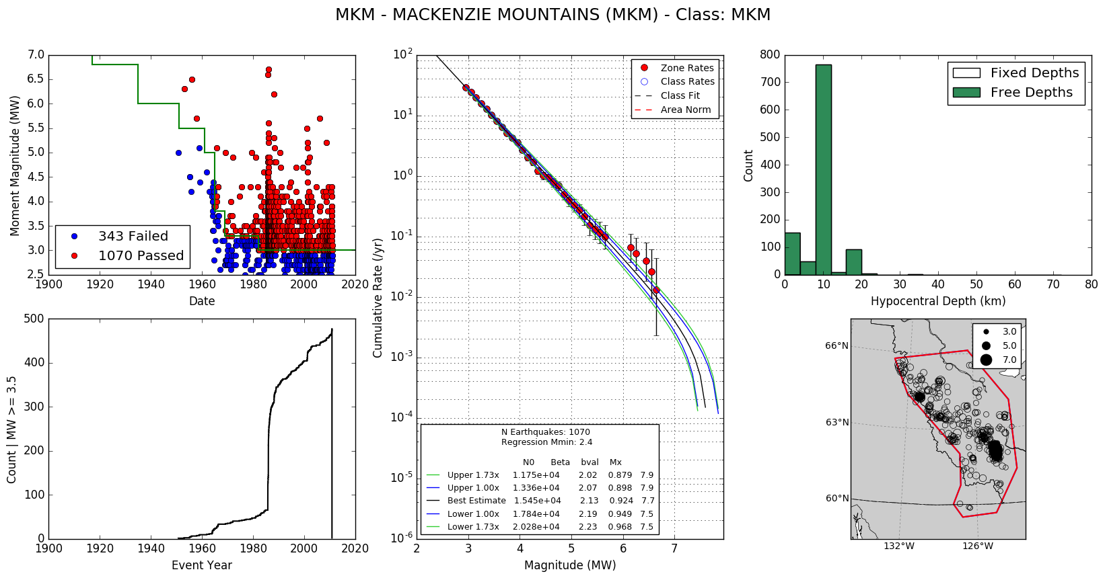
Non-declusterd Catalogue

Slide 15
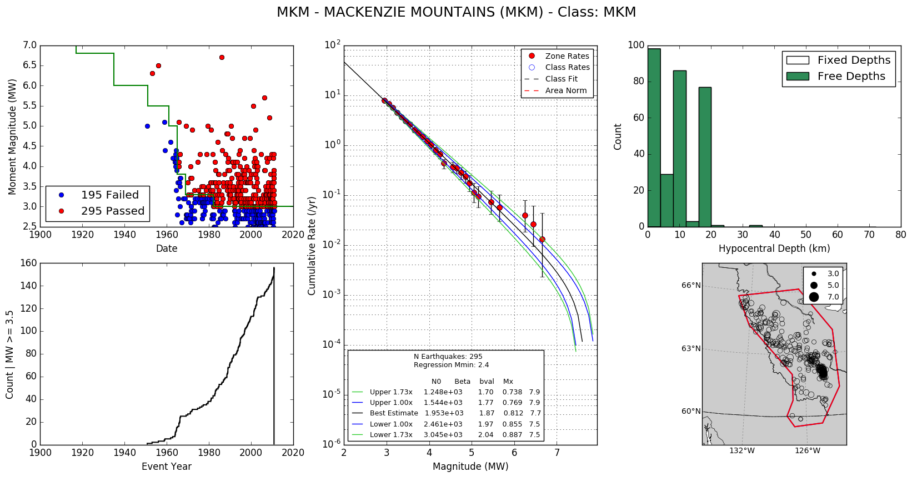
Declusterd Catalogue

Slide 16
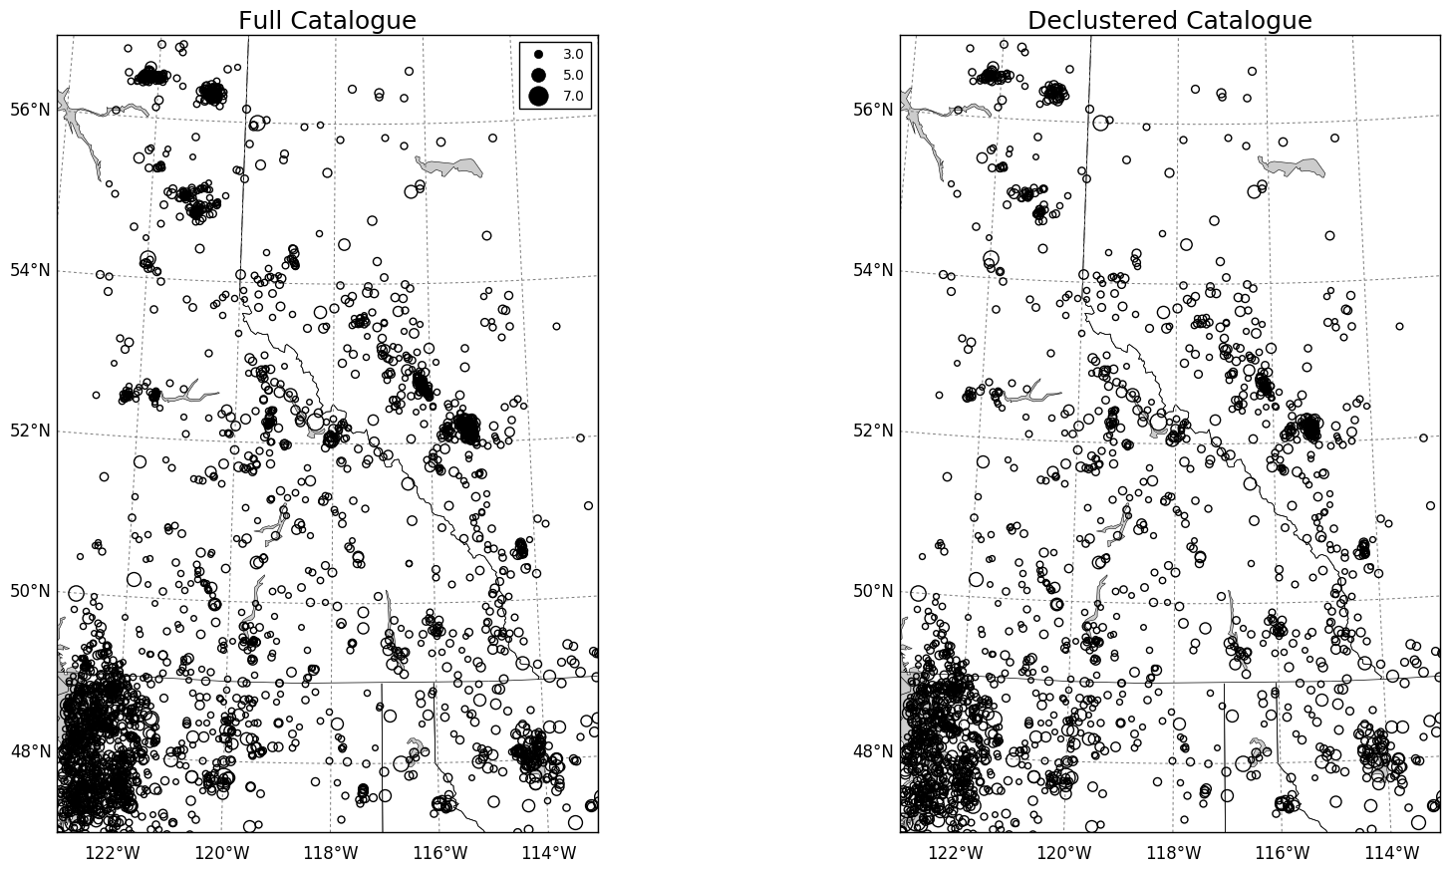
Declustering: Rocky Mtns

Slide 17
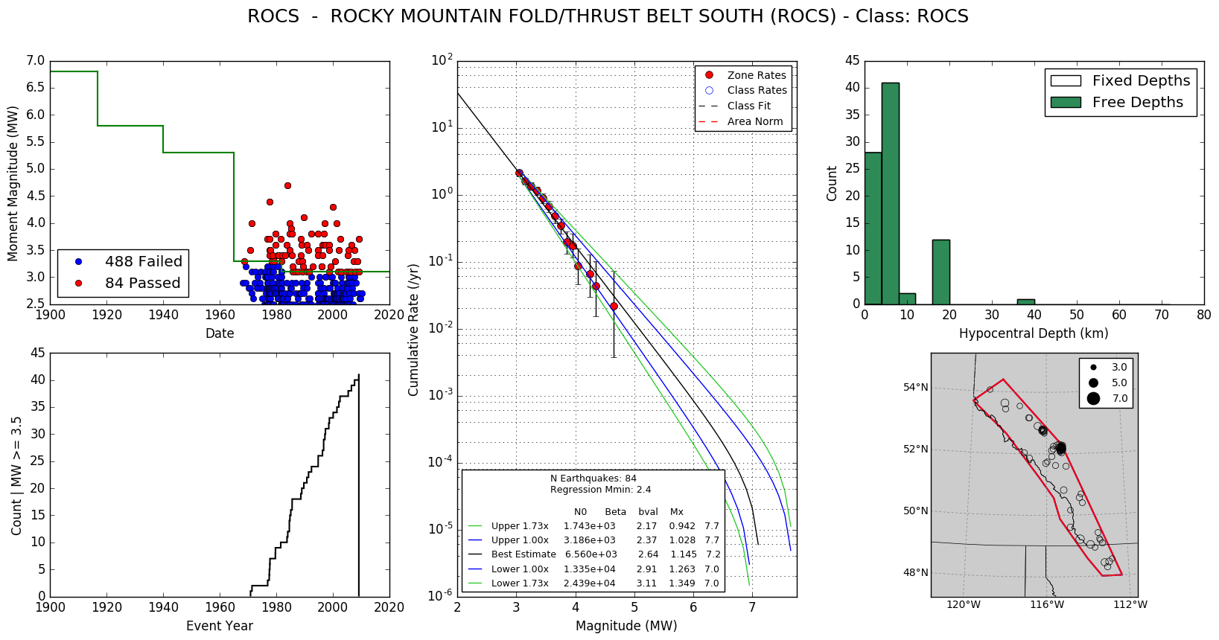
Non-declusterd Catalogue

Slide 18
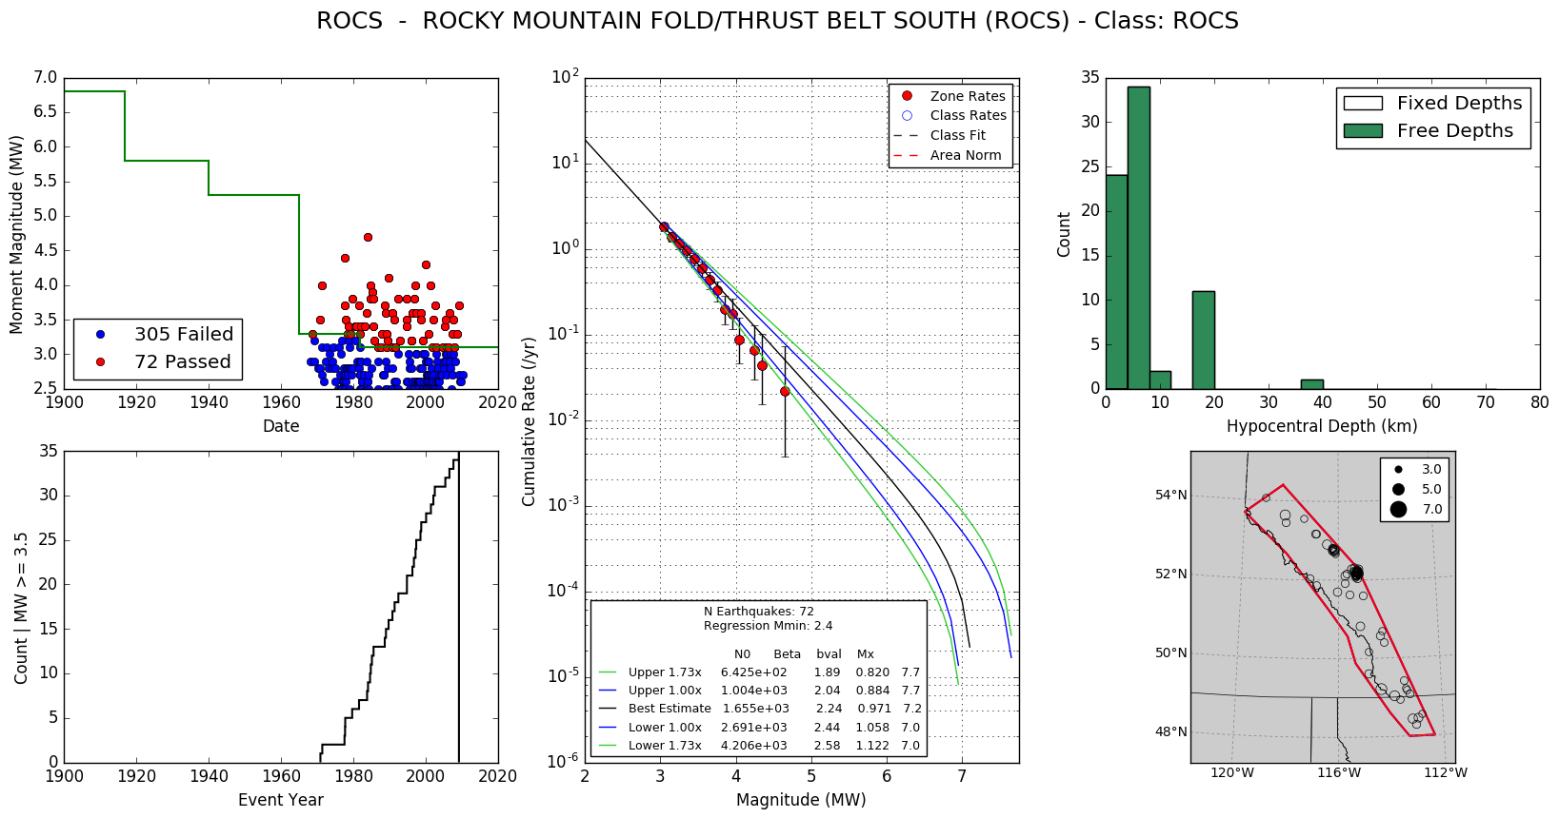
Declusterd Catalogue

Slide 19
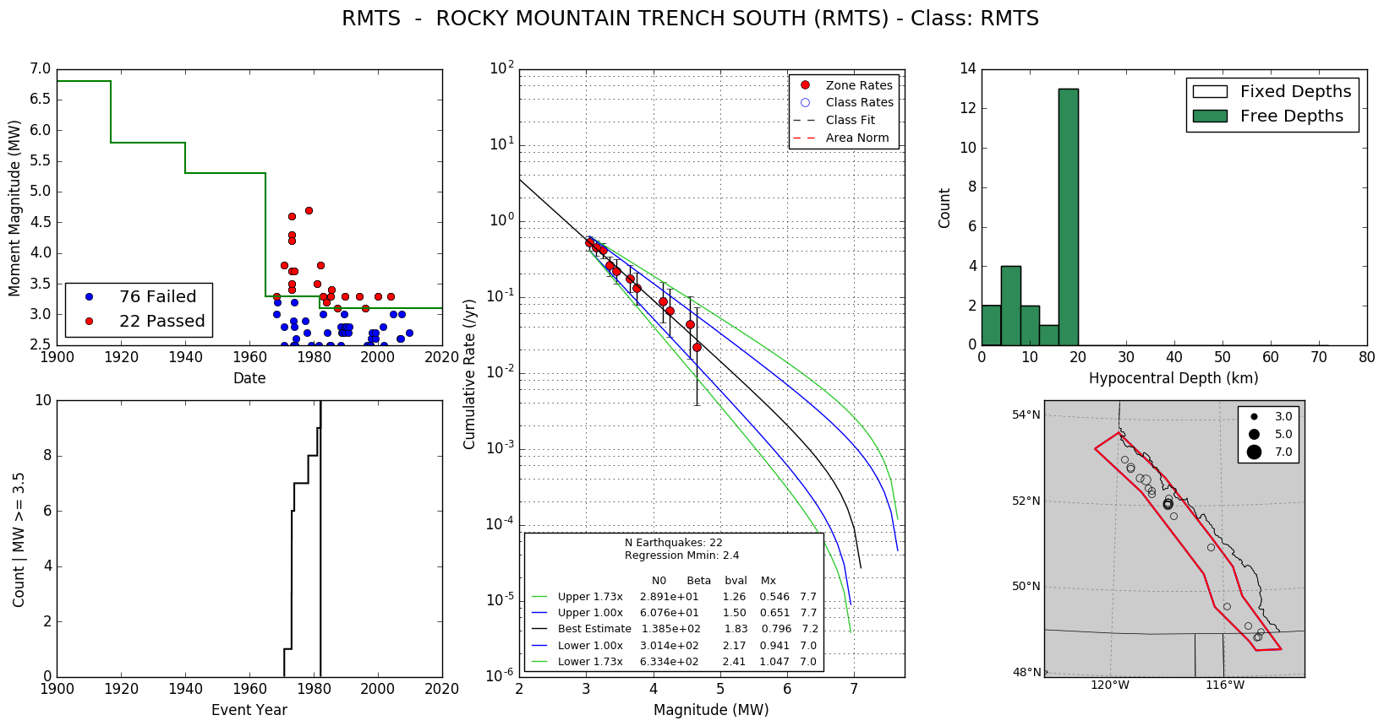
Non-declusterd Catalogue

Slide 20
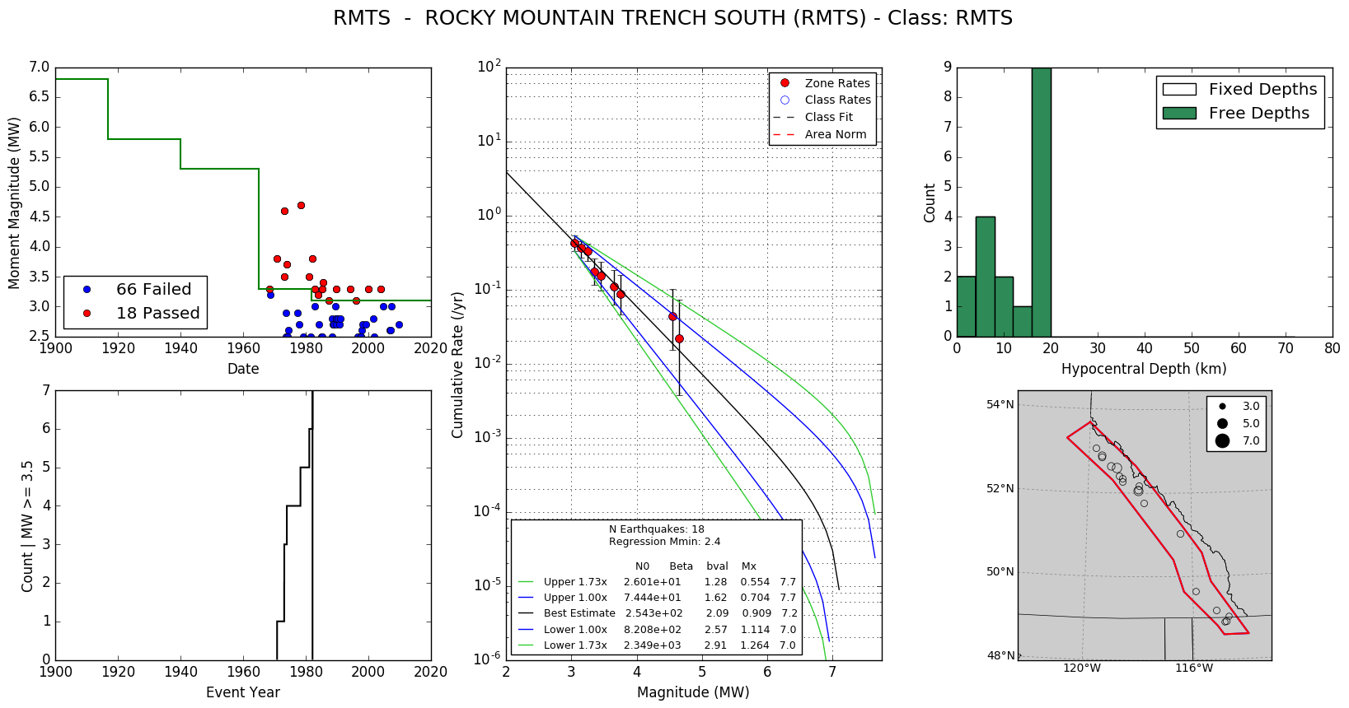
Declusterd Catalogue

Slide 21
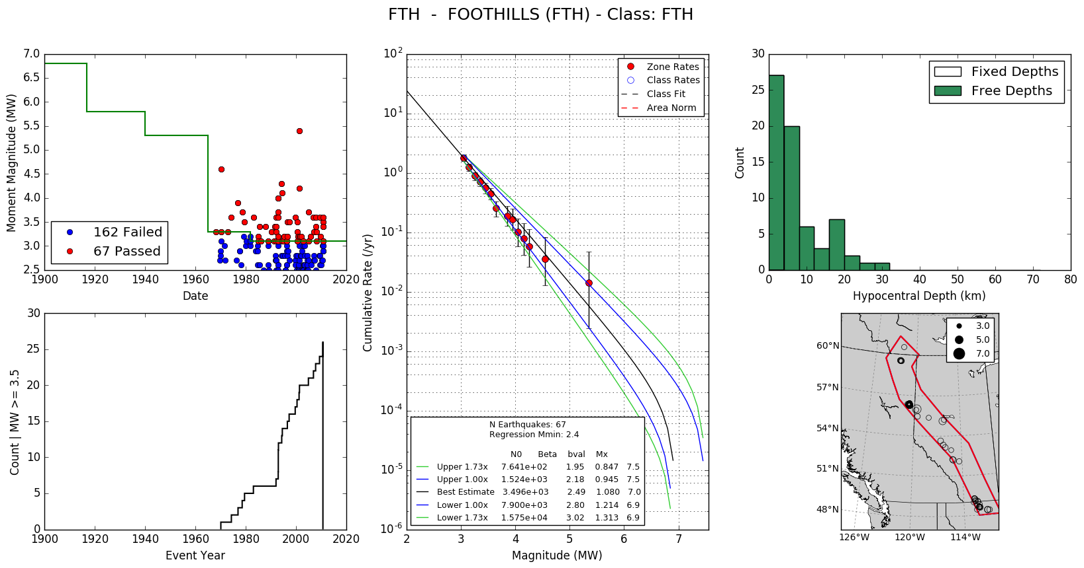
Non-declusterd Catalogue

Slide 22

Declusterd Catalogue

Slide 23
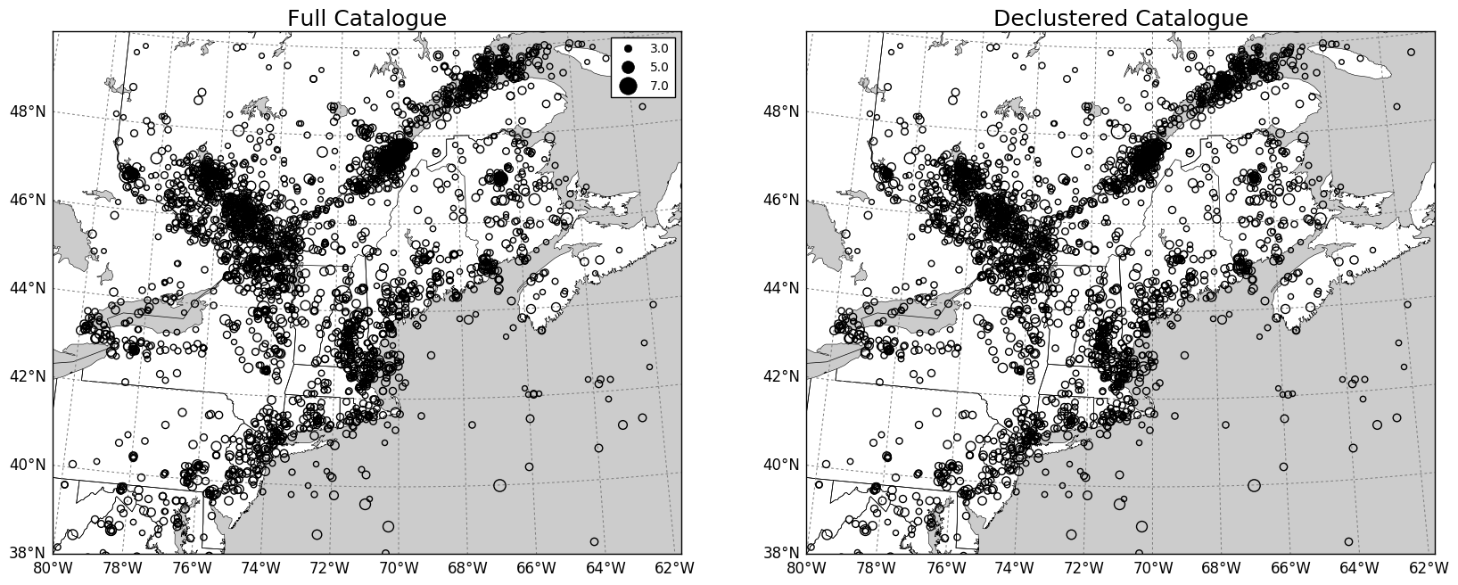
Declustering: Eastern Canada

Slide 24
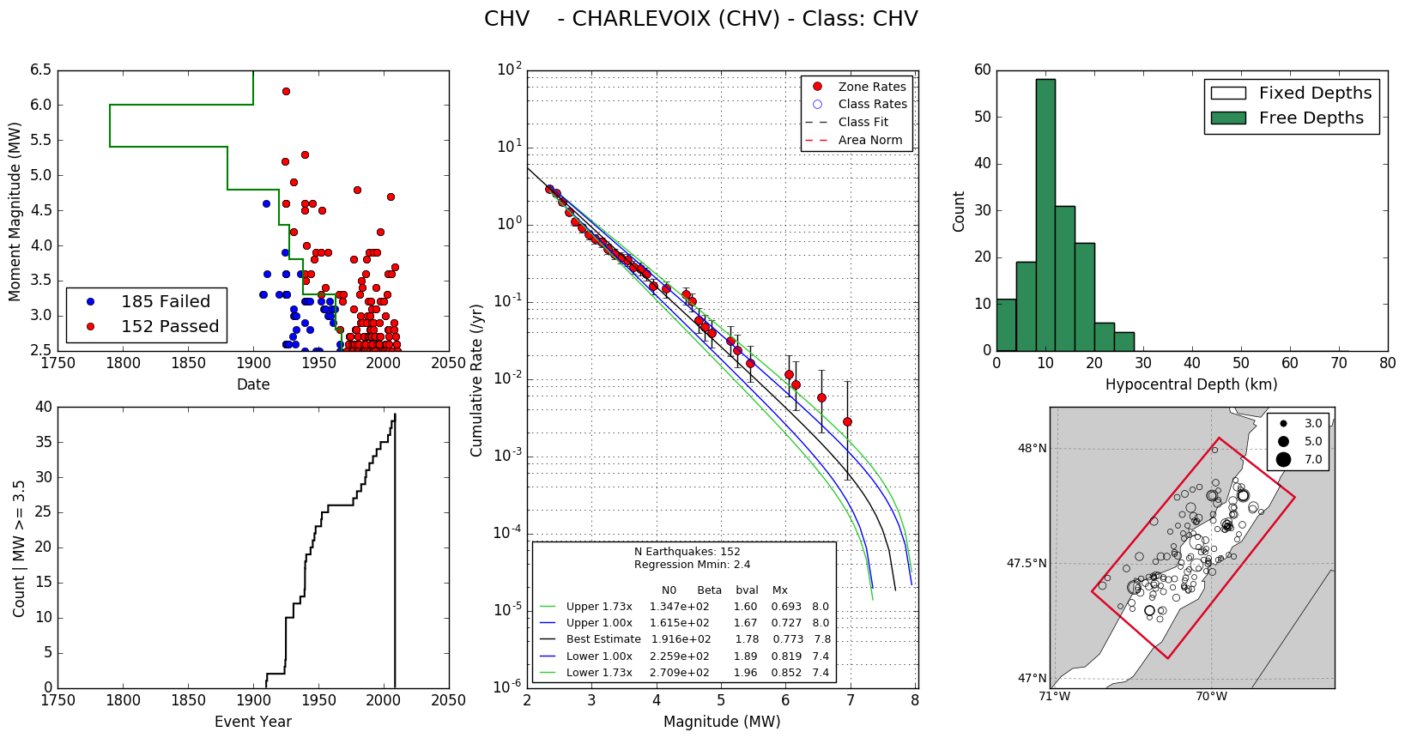
Non-declusterd Catalogue
This is a bug in my plotting, not my consideration of completeness!

Slide 25
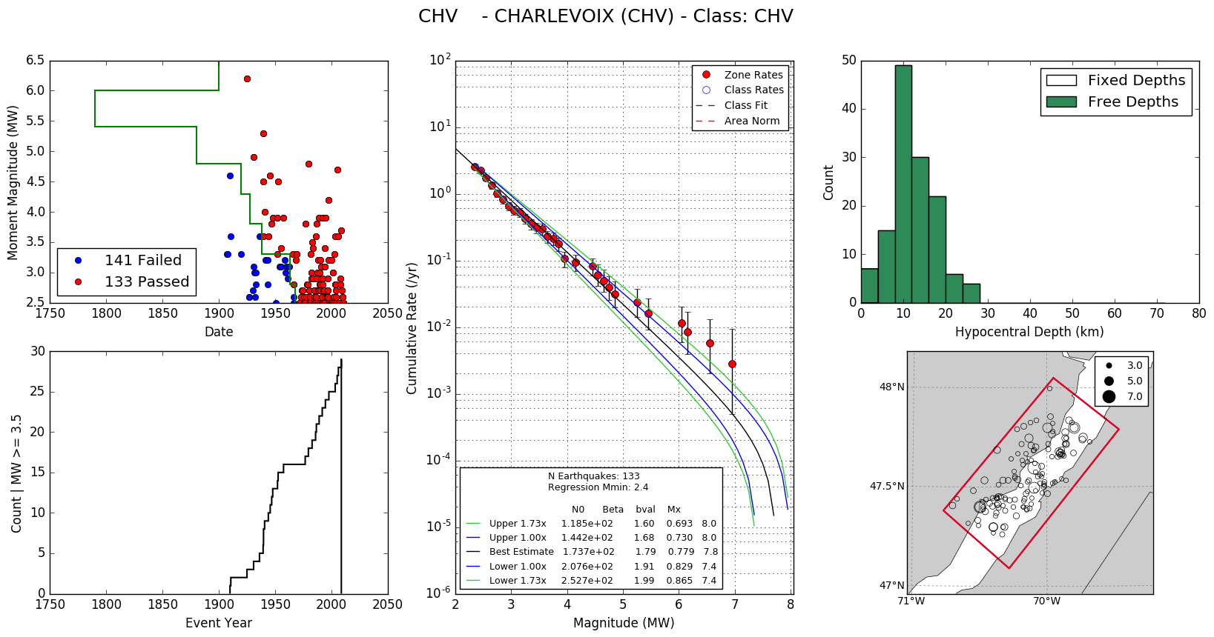
Declusterd Catalogue

Slide 26
Non-declustered b-value

Slide 27
Declustered b-value

Slide 28
Rates of M_{W} 5.0 (Non-declusterd)

Slide 29
Rates of M_{W} 5.0 (Declusterd)

Slide 30
Rates of M_{W} 6.0 (Non-declusterd)

Slide 31
Rates of M_{W} 6.0 (Declusterd)

Slide 32
5.3.1: Seismic Source Model
Alternative source model in the West:
smoothed seismicity, BC Hydro, other?
Inclusion of Leech River / Devil’s Mountain Fault Systems (southern Vancouver Island)
Stepped Cascadia in-slab sources
Revision of slip rates for some fault sources (e.g. Eastern Denali, YK)
Simplification of Eastern source model?

Slide 33
Modified Western Source Model
Modification of some area sources to better reflect historical seismicity and geologic structure:
Added sources bounding the Rocky Mountain Trench
Split Coast Mountains (CST) into two narrower zones to better reflect geologic structure and seismicity
Split Puget Sound Deep and extended landward

Slide 34
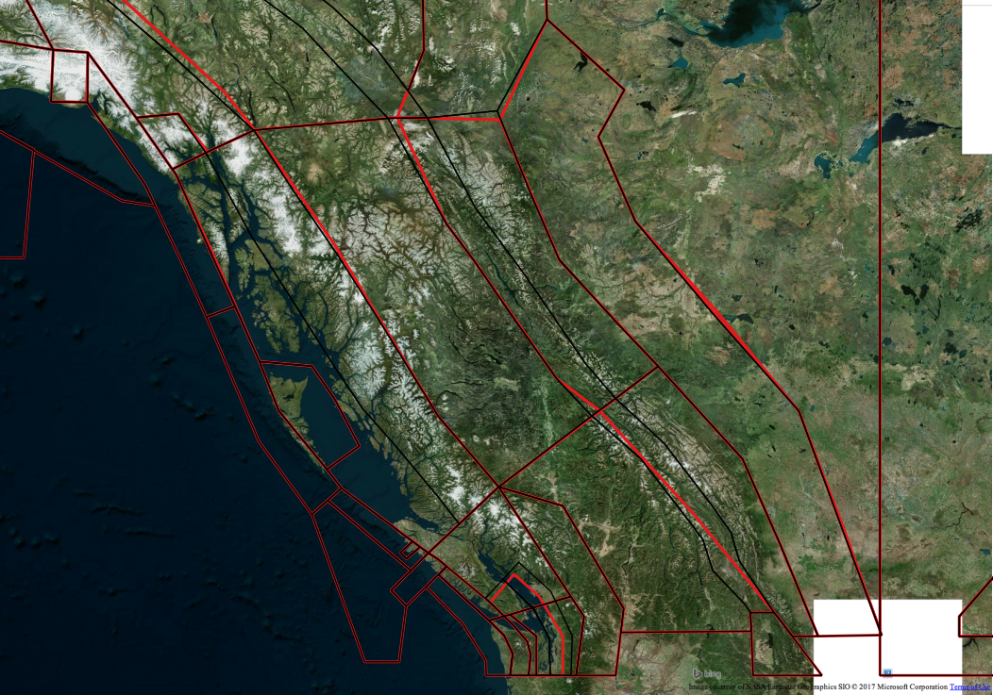
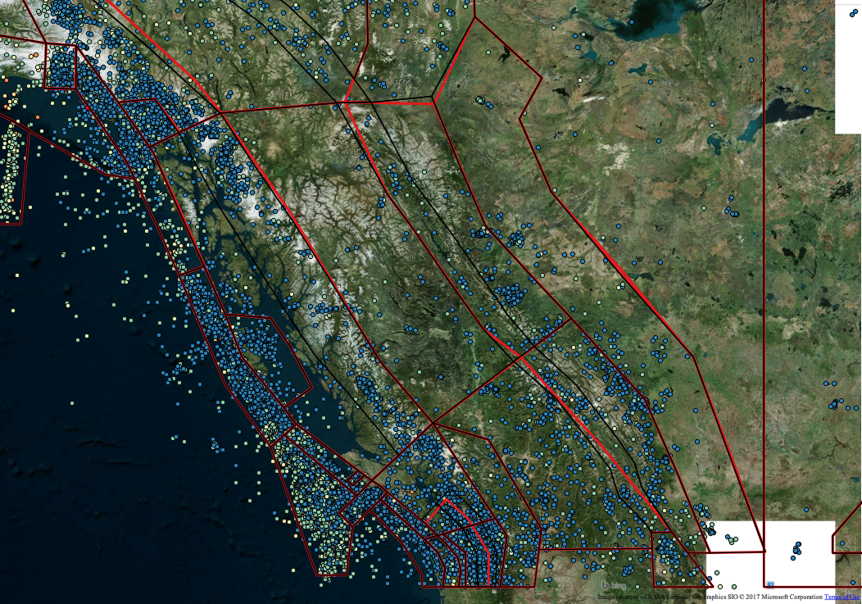
Modified Western Source Model
2015 NBCC
Modified

Slide 35
5.3.2: Smoothed Seismicity
Initial smoothed seismicity models developed using fixed-kernel smoothing have been generated:
Using OQ HMTK implementation
Uses a smoothing kernel of 50 km, b-value=1.0 and Mmin=3.0
Use declustered catalogue
A grid of activity rates has been produced
Not yet convinced by the results
Elliptical nature of smoothed model suggests distances are based on lat/lon in degrees rather than in km

Slide 36
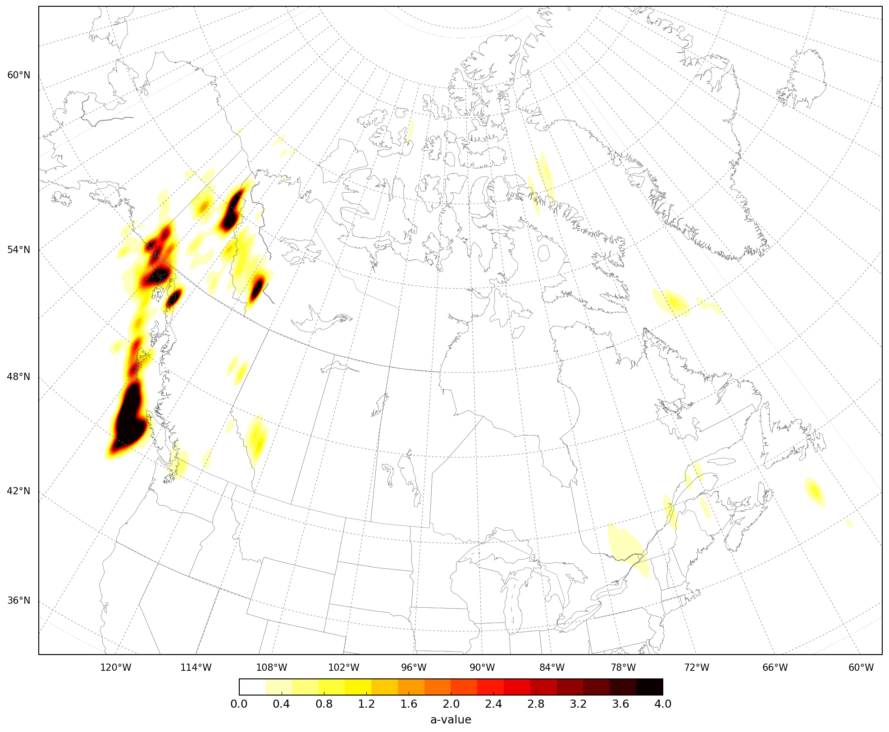

Slide 37
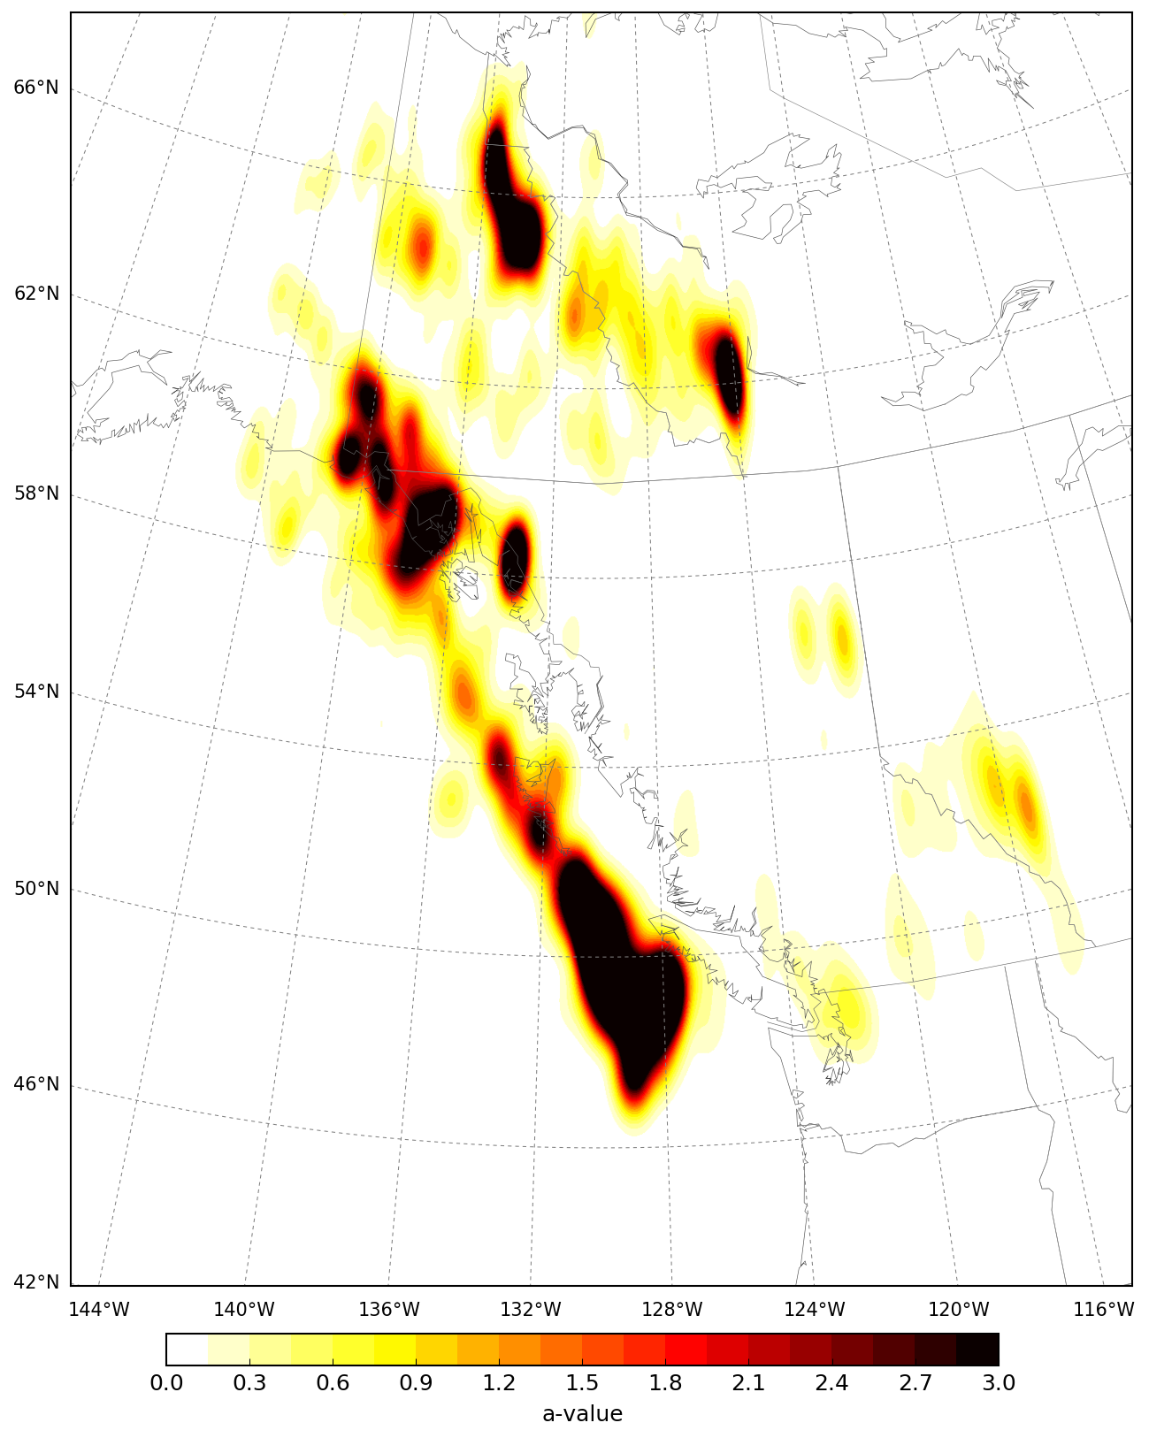

Slide 38
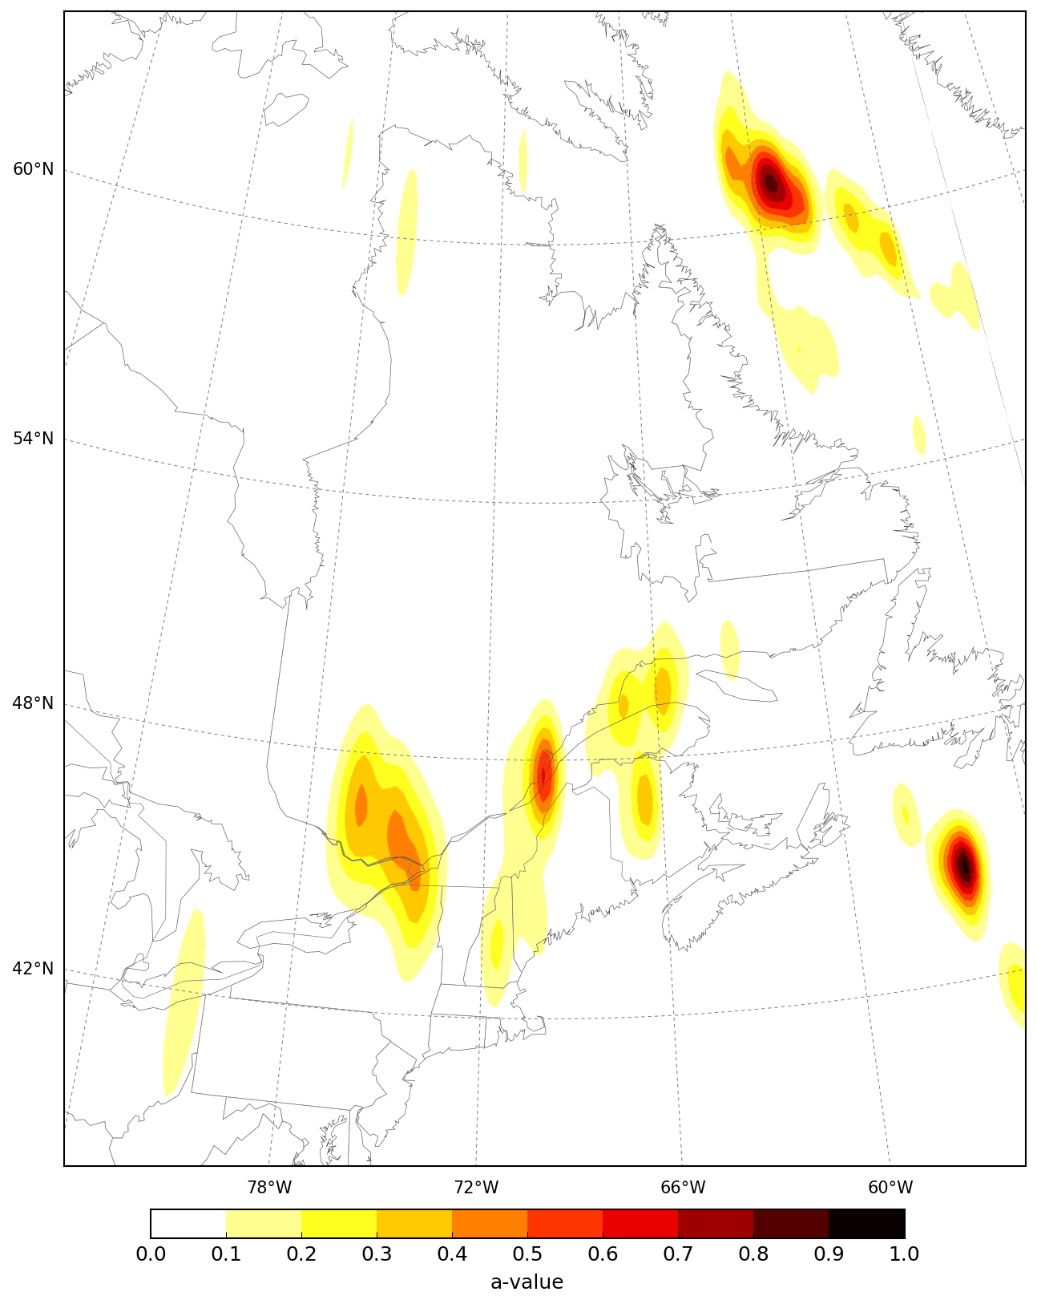

Slide 39
5.3.3 Leech River / Devil’s Mtn Fault System
Two studies have identified potentially active crustal faults in the southern Vancouver Island region
Tectonically driven Holocene faulting identified in the Leech River Valley
DMF included in USGS model
LRF used in BC-Hydro model

Slide 40
LRF/DMF Logic Tree
slip rate is given based on slip rates of Johnson et al. (2001)
Seismogenic thickness = 15 km (down-dip fault width approx. 16 km)
Fault dip = 70 degrees to North

Slide 41
Short Period Impacts of SWBC Faults

Slide 42
Long Period Impacts of SWBC Faults

Slide 43
5.3.8: Dipping Source for Puget Sound: Option 1
Distribute activity rates for the intraslab GTP zone across three appox equal area sources at different depths
The 2015 model used a simple “flat” source zone at 50 km that undelays the crustal source zone
Seismicity TG suggests representing the dipping slab more appropriately
2015 GTP source becomes deeper as it approaches mainland
Hazard is reduced by about 4-12%

Slide 44
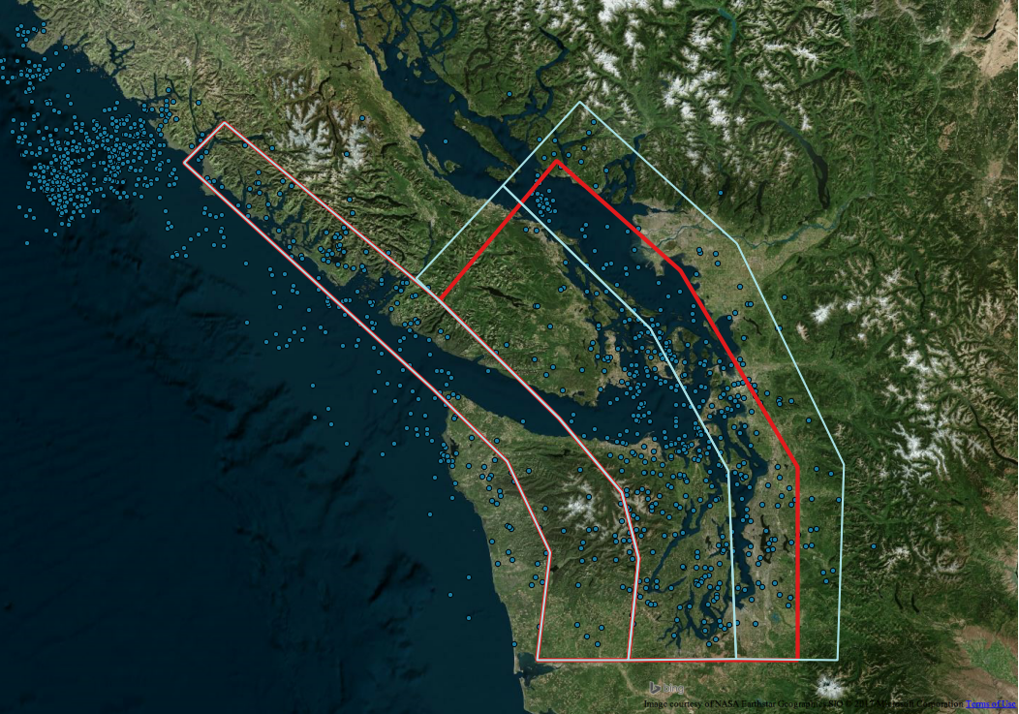
5.3.8: Dipping Source for Puget Sound: Option 2
Split GTP and treat as two (or three) independent sources
Move deep sources further landward to capture deep earthquakes
This may increase Vancouver’s short-period hazard from 2015

Slide 45
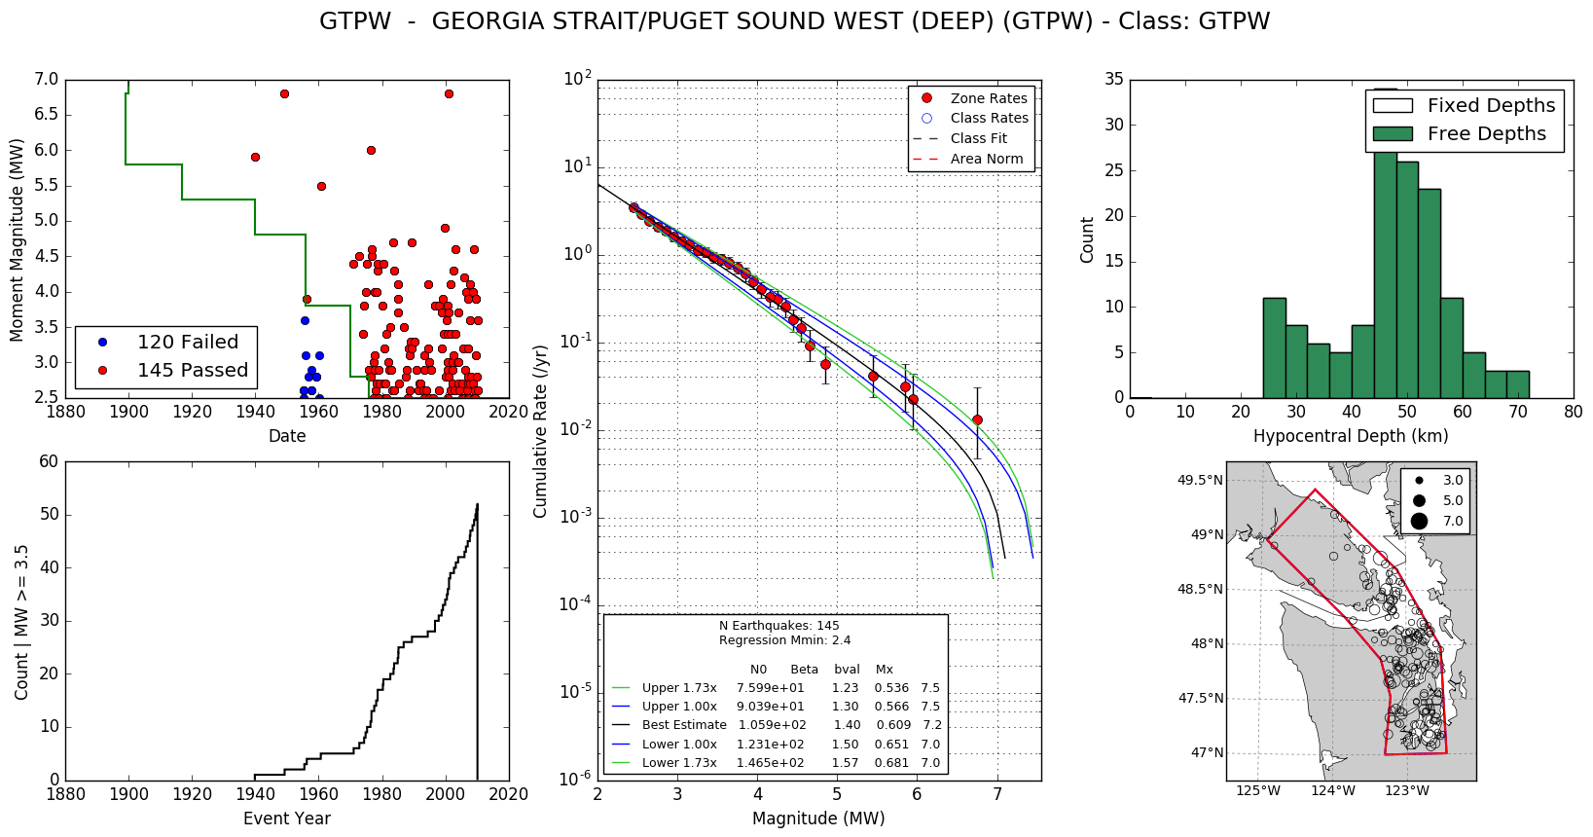
GTP - West

Slide 46
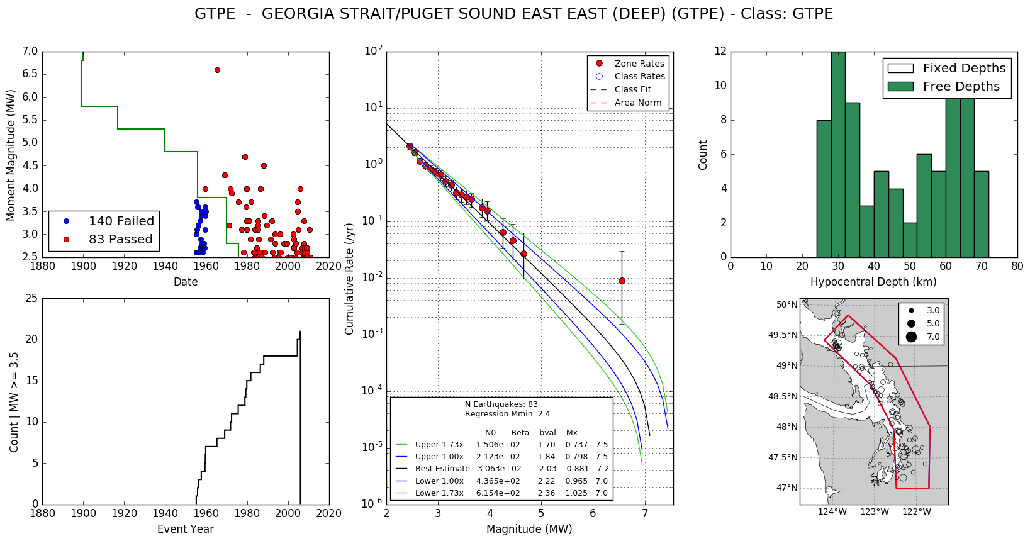
GTP - East

Slide 47
5.3.4 Updated Cascadia Interface Rates
New data suggests the average return period for Cascadia megathrust earthquakes is shorter (Goldfinger et al. 2016)
2015 NBC assumed return period of 550 yrs
Identified 23 Holocene turbidites
New return period is estimated at 430 yrs

Slide 48
5.4: Ground-Motion Models for 2020 NBC
2015 NBC used Atkinson & Adams (2013) GMMs using the referenced backbone approach:
Upper & lower models capture variability among models
Simplifies hazard calculations/computationally efficient
Several advances have been made in GM modelling since the AA13 models developed:
NGA-West2 (AA13 informed by these models)
NGA-East (seed models published – models for USGS hazard maps are available)
Being implemented into OQ
NGA-Subduction (underway - no models available)

Slide 49
5.4.1: Ground Motion Model – Crustal EQs
NGA West 2 (2014): 2/3 Weight (California/Global)
Abrahamson et al (1/6)
Boore et al (1/6)
Campbell & Bozorgnia (1/6)
Chiou & Youngs (1/6)
Akkar et al (2014): 1/3 Weight (Europe/Middle East)
Shown to perform well for 2012 Haida Gwaii sequence (Allen & Brillon, 2015)
NGA-West1 found to be suitable for Europe (Stafford, 2009)

Slide 50
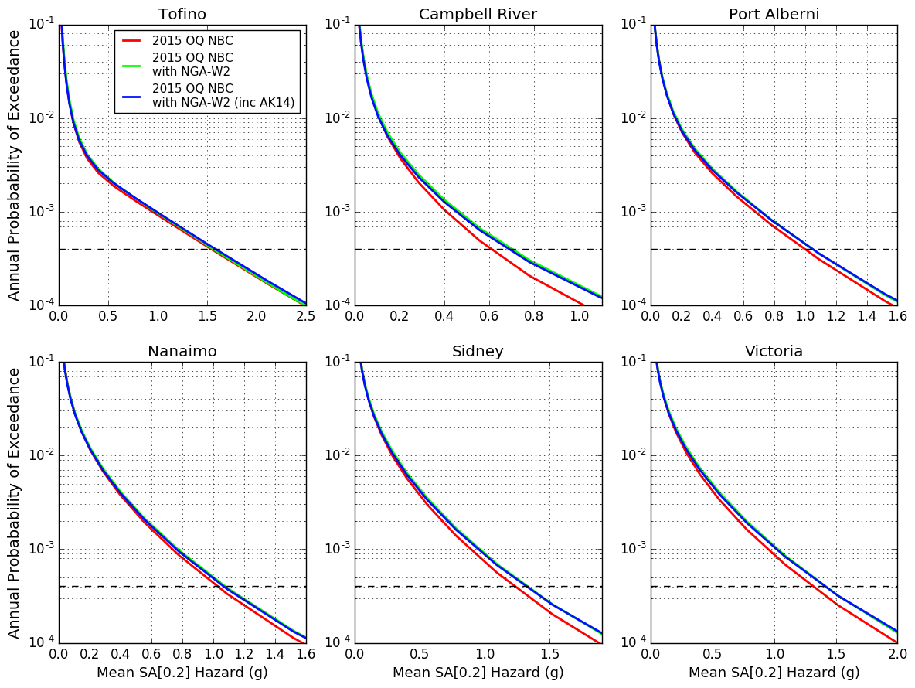
Short Period

Slide 51
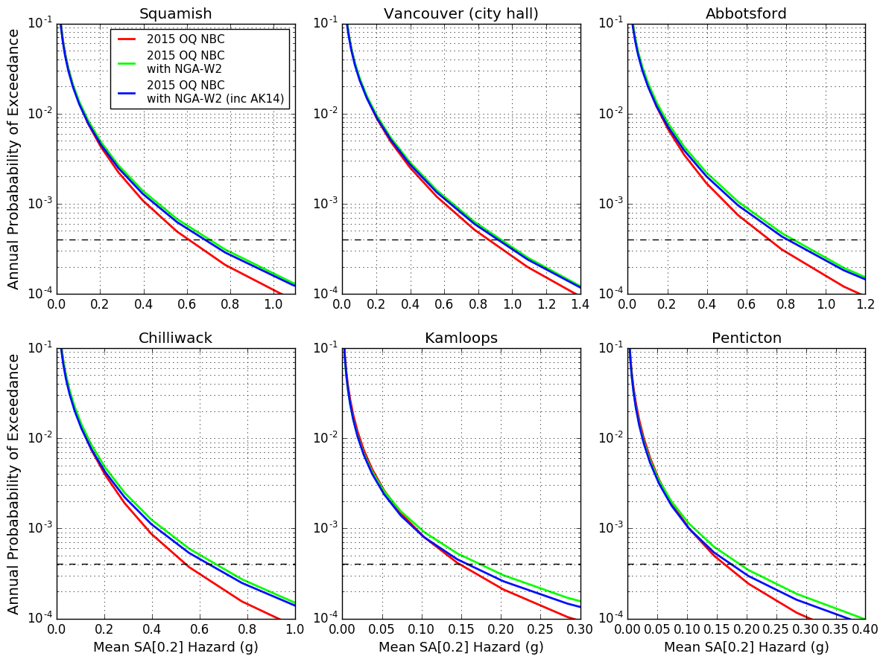
Short Period

Slide 52
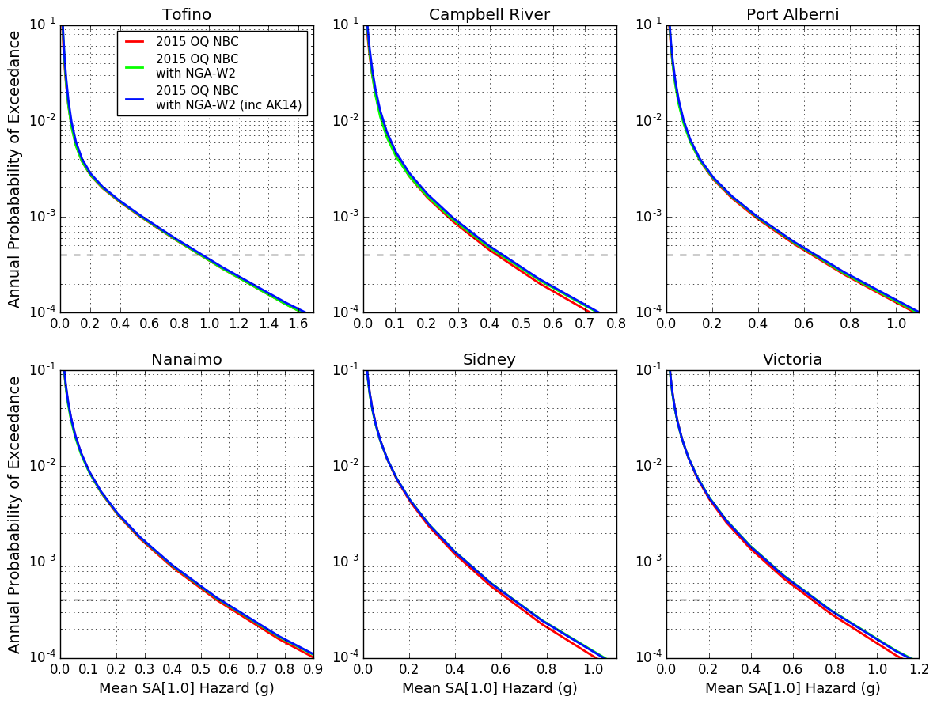
Long Period

Slide 53
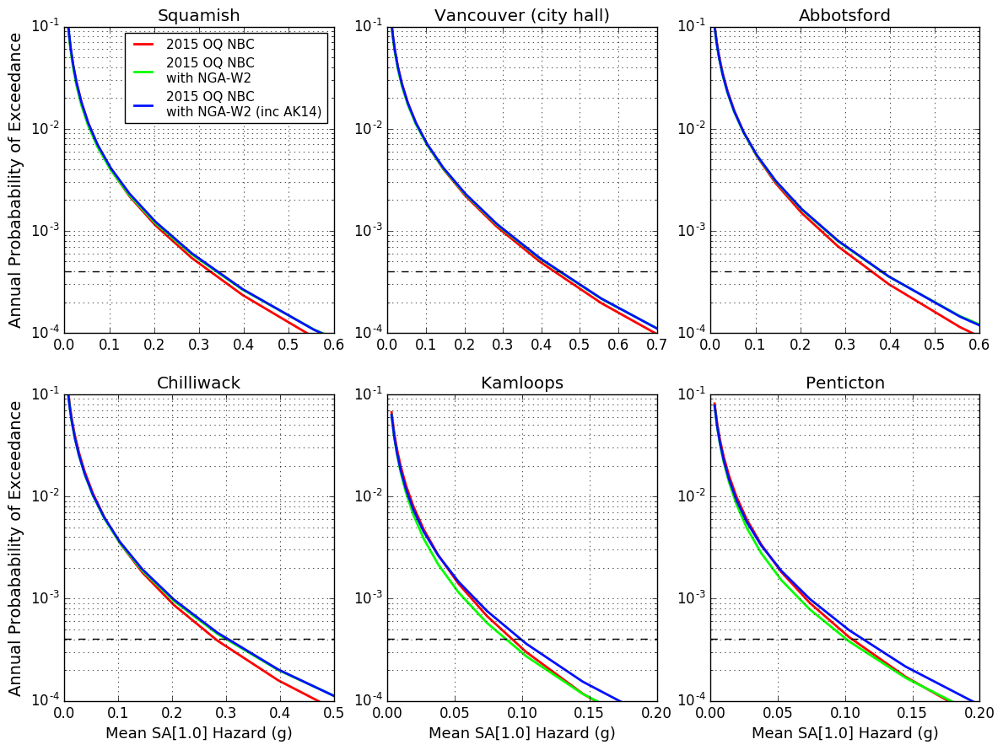
Long Period

Slide 54
NGA-W2 Short Period Differences

Slide 55
NGA-W2 Long Period Differences

Slide 56
Impact of Change in Crustal EQ GMPEs
Not much!
Slight increases at short periods
No significant changes at long periods

Slide 57
5.4.3: Ground Motion Model – Intraslab GMMs
Proposed GMMs:
Atkinson & Boore (2003): 1/8
Atkinson & Boore (Cascadia; 2003): 1/8
Garcia et al. (2005): 1/4
Zhao et al. (2006): 1/8
Zhao et al. (Cascadia; 2006): 1/8
Abrahamson et al (BC-Hydro; 2015): 1/4
Brillon (in prep) demonstrated that AB03 and Gea05 models best matched recorded data from Cascadia

Slide 58
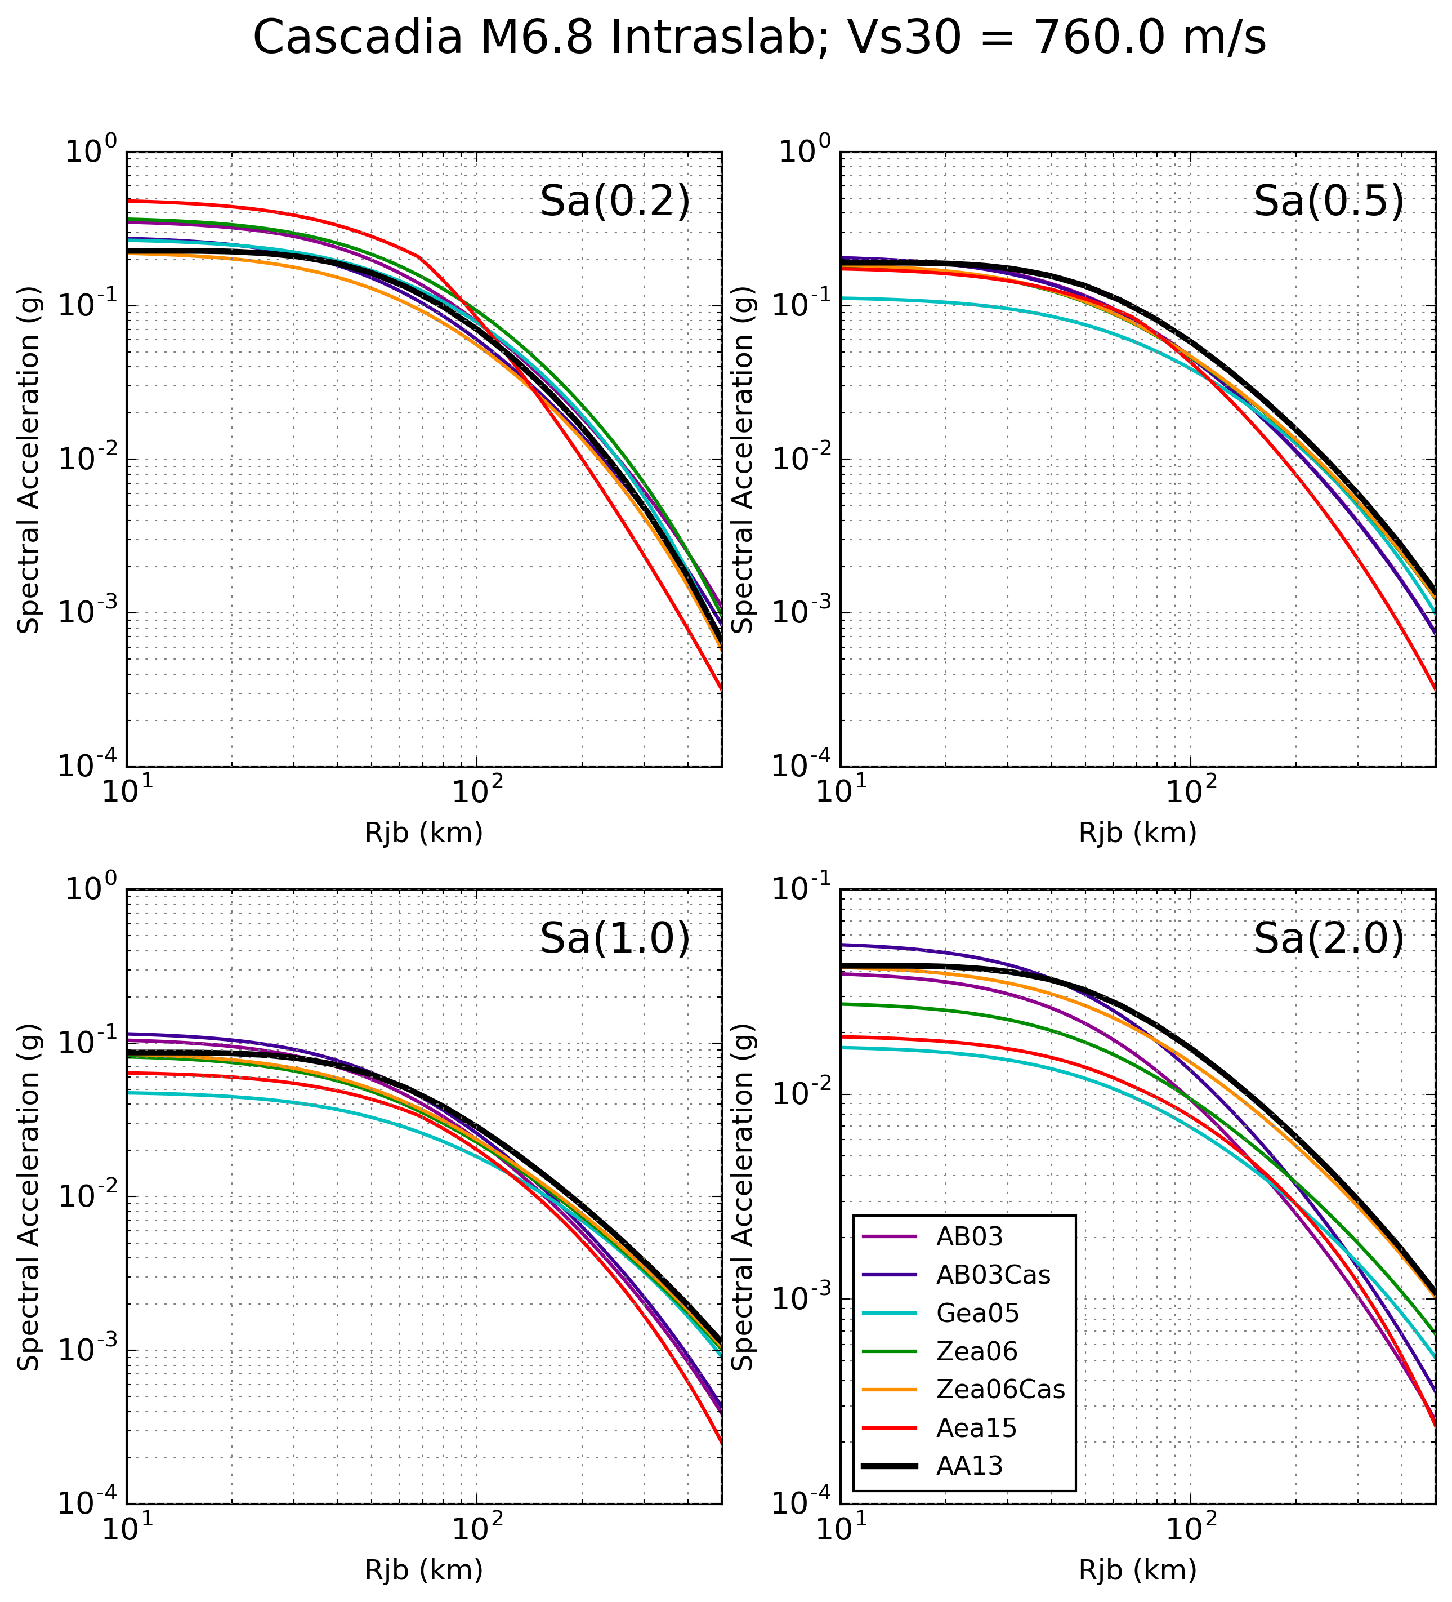
Intraslab GMM Behavior

Slide 59
5.4.3: Ground Motion Model – Interface GMMs
Proposed GMMs:
Zhao et al. (2006): 1/8
Zhao et al. (Cascadia; 2006): 1/8
Atkinson & Macias (2009): 1/4
Ghofrani & Atkinson (2014): 1/8
Ghofrani & Atkinson (Cascadia; 2014): 1/8
Abrahamson et al (BC-Hydro; 2015): 1/4
Similar representation of GMMs from 2015 model
Down-weight “Cascadia” models as they are less likely to be appropriate for Vancouver Island

Slide 60
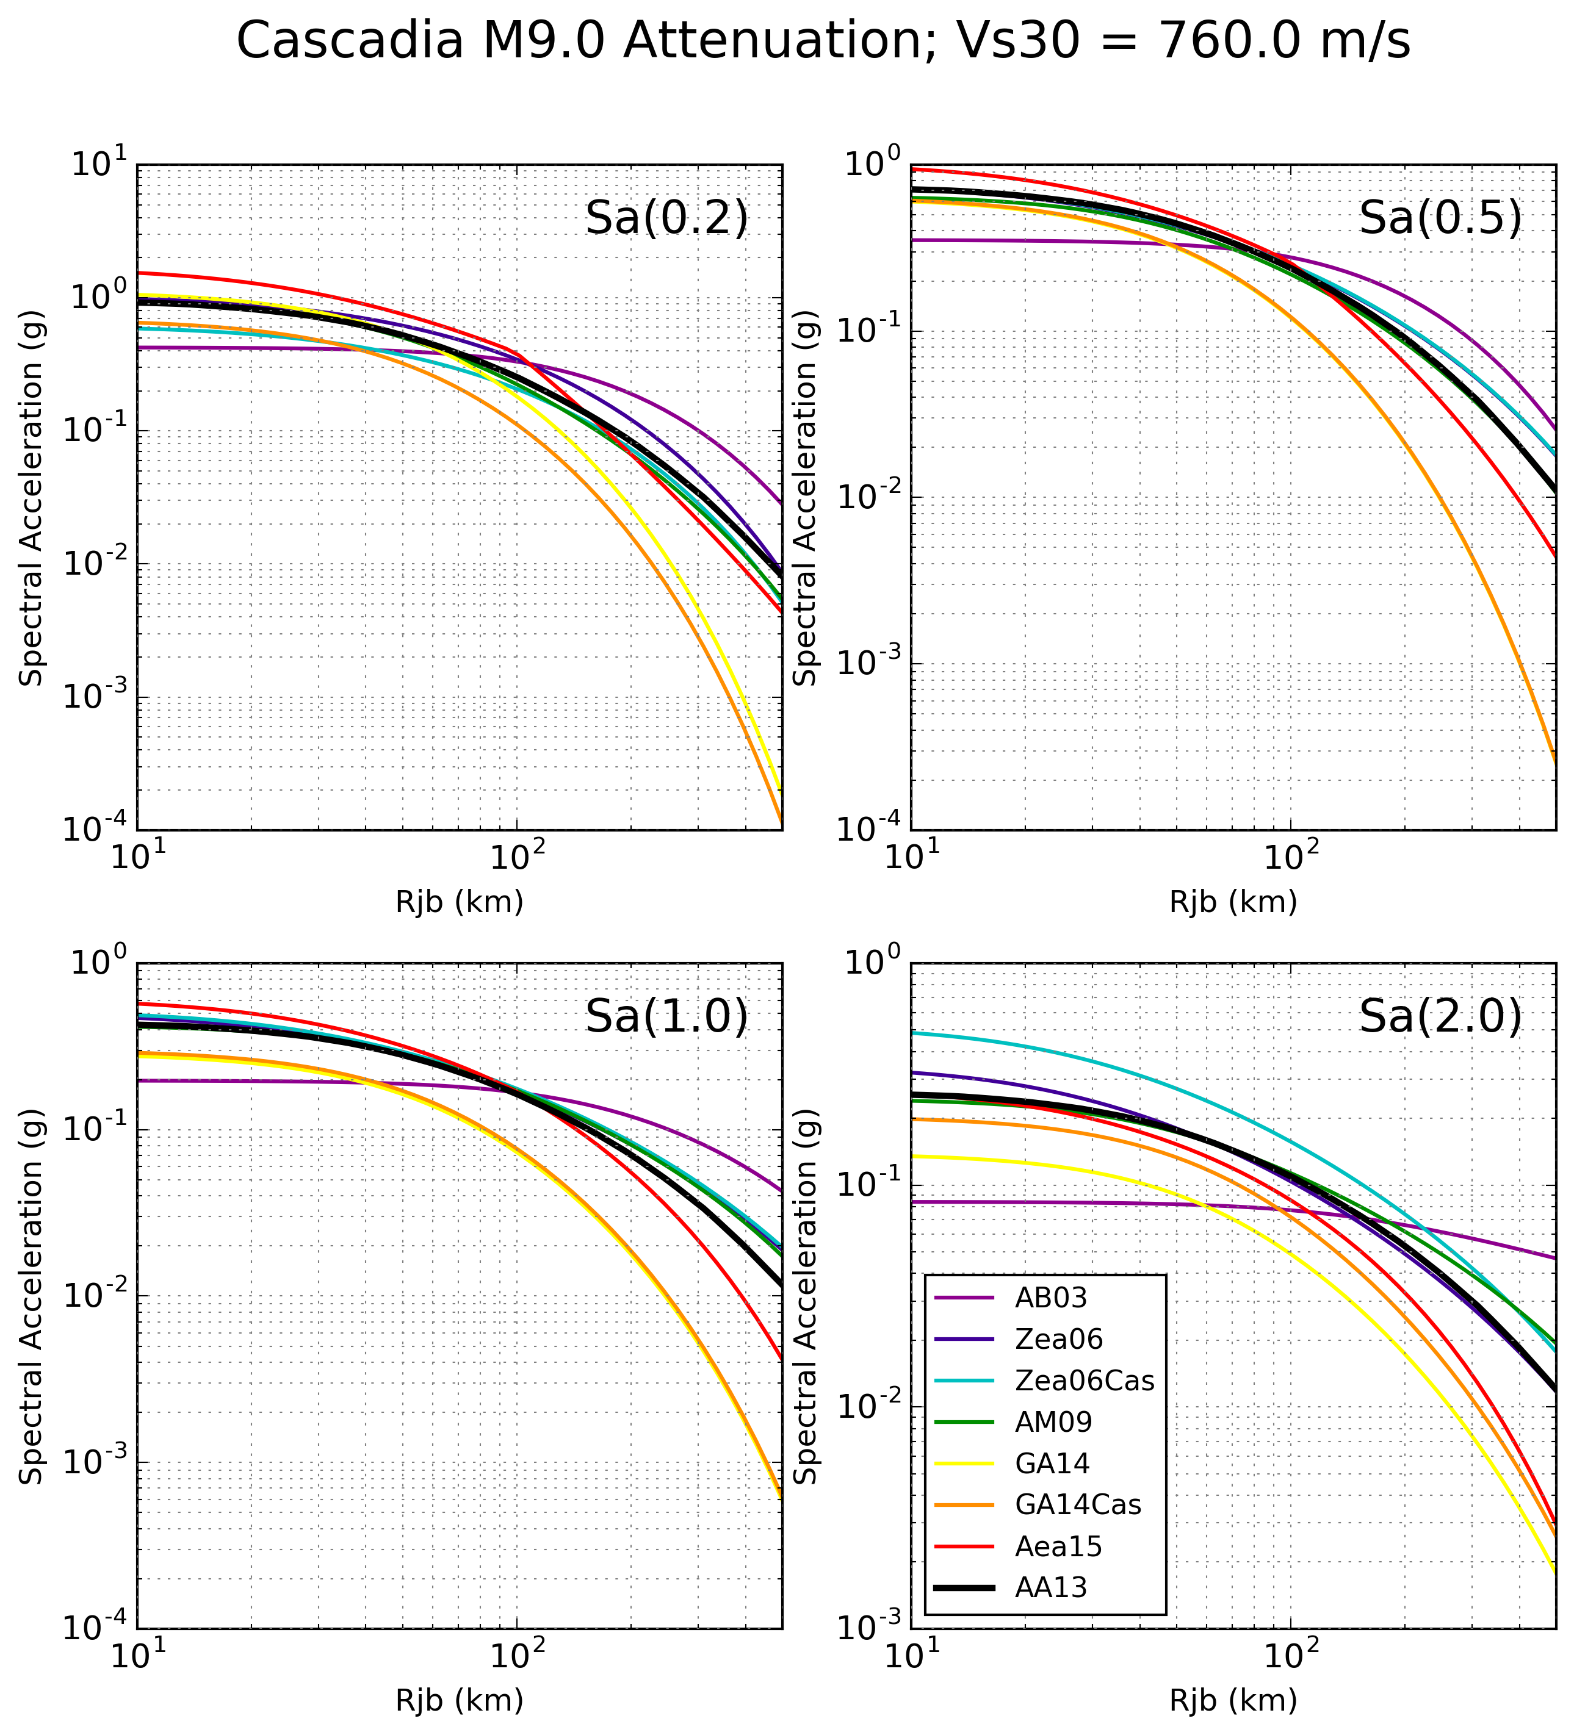
Interface GMM Behavior

Slide 61
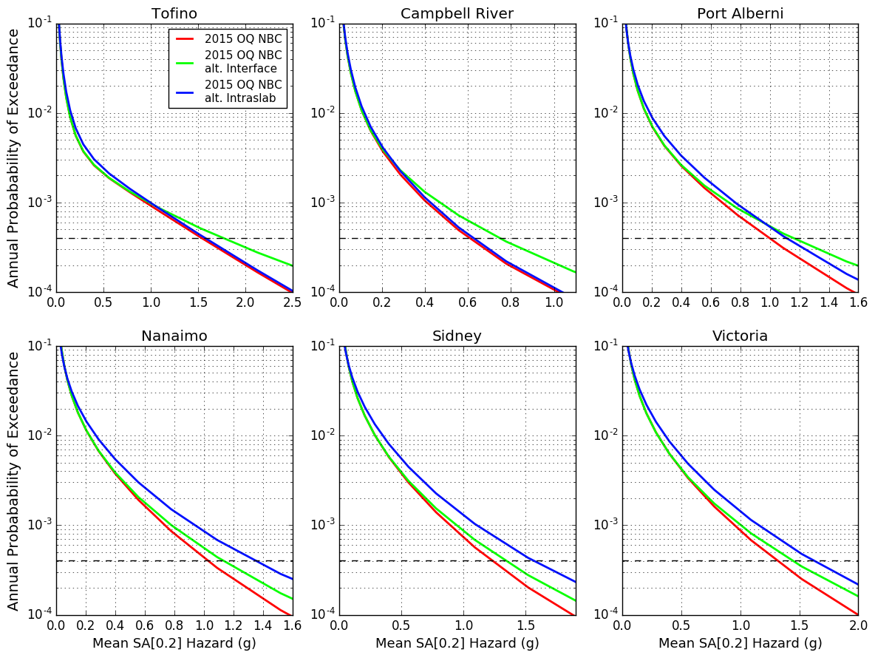
Short Period

Slide 62
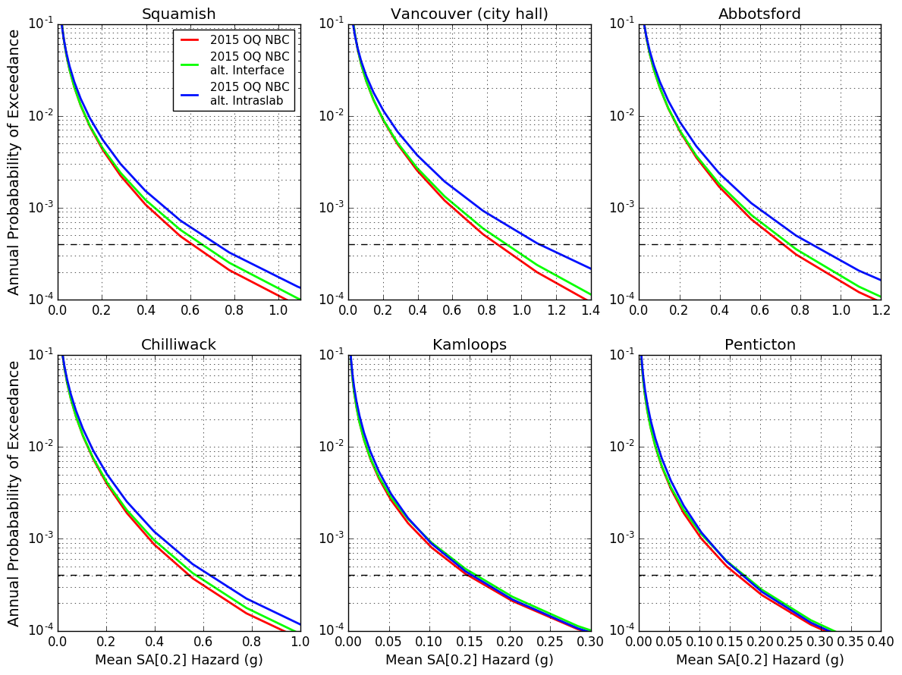
Short Period

Slide 63
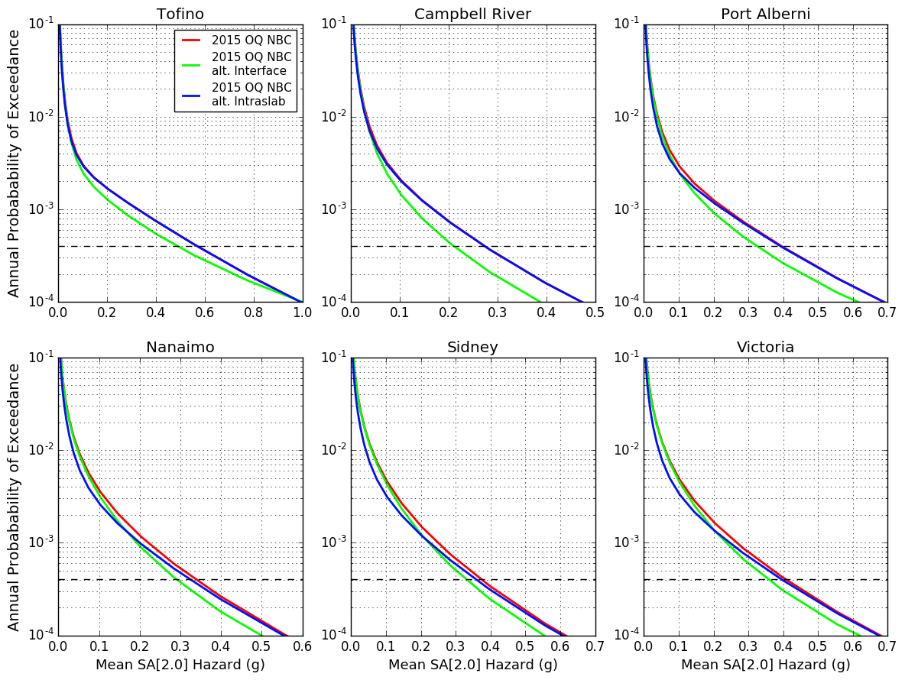
Long Period

Slide 64
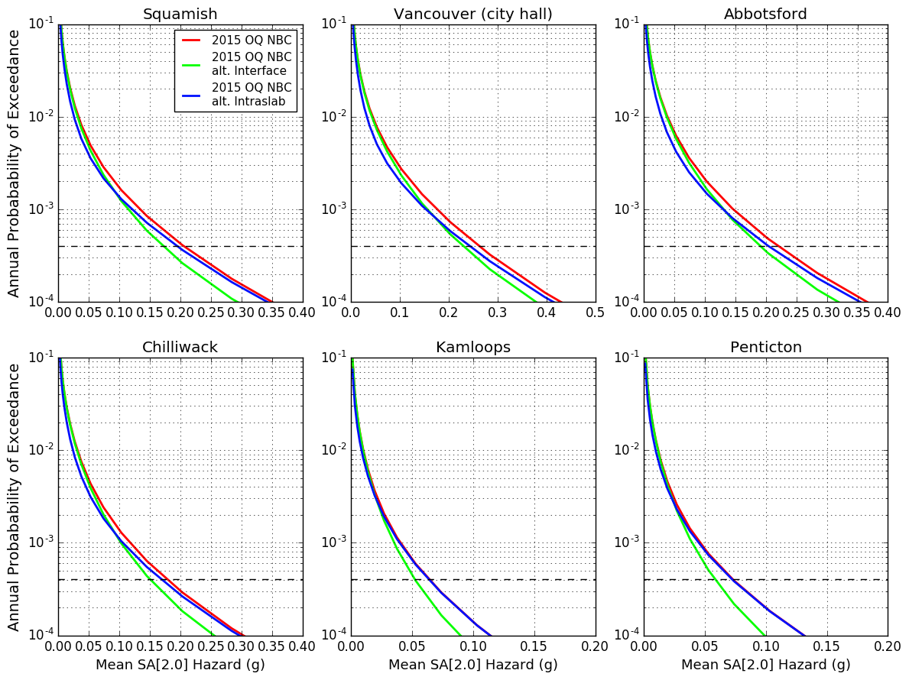
Long Period

Slide 65
5.4.3: Ground Motion Model – Eastern GMMs
Potential GMMs:
Atkinson & Adams (2013) – as used for 2015 NBC
Or
Use NGA-East seed models (e.g. Yenier & Atkinson, 2015)

Slide 66
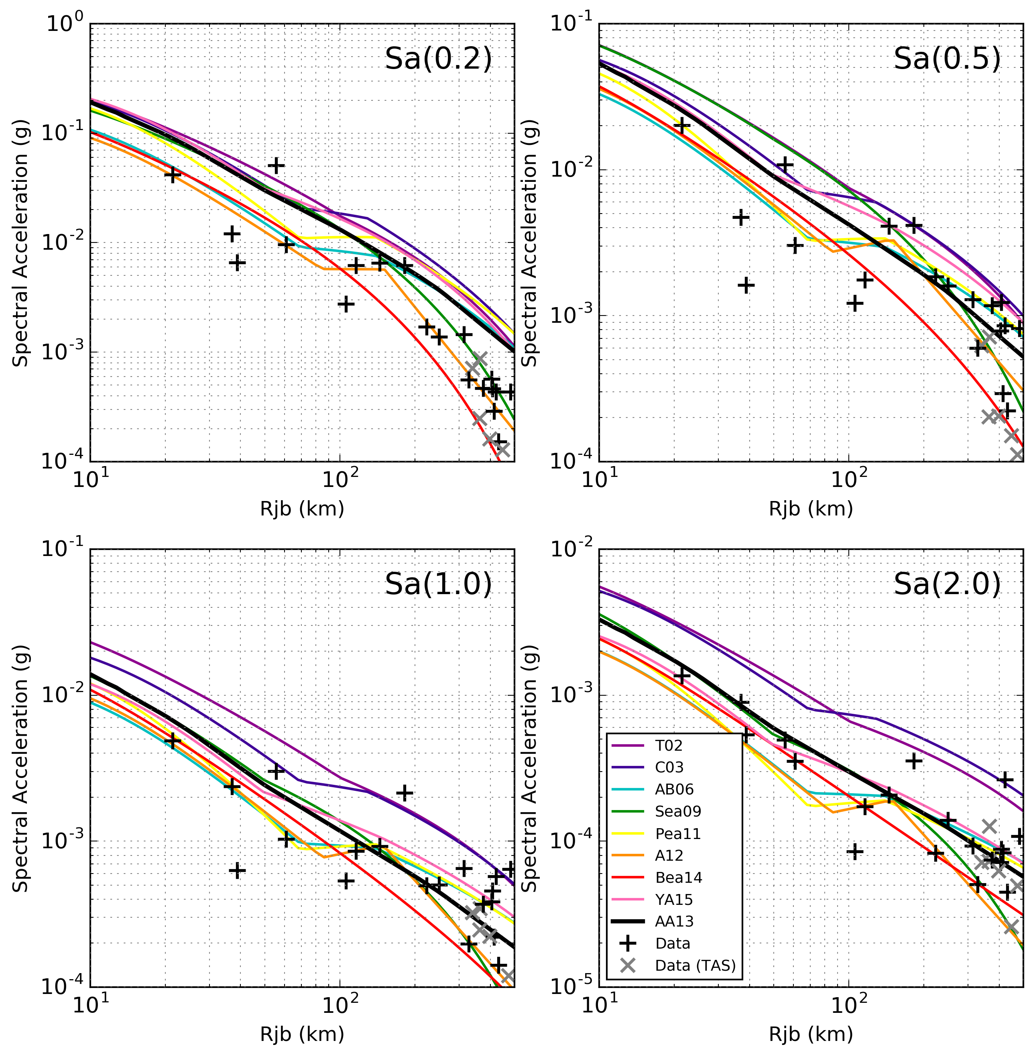
SCR GMM Behavior
Data from the 2012-06-19
Mw 5.0 Moe, Australia earthquake

Slide 67
Updated Hazard Calculations for SW BC

Slide 68
5.5: Engineering Applications
Near-fault design ground motions
Define “near-fault”
Guidance on selecting ground motion time-histories for near-fault sites
Other considerations?
Consideration of long-duration Cascadia subduction motion (non-time-history analysis)

Slide 69
5.5.8: Cross-Committee Coordination with SC-HSB
TG recommended that SC-HSB be made aware of the trend in the updated seismicity values particularly in the west, and potential values exceeding current threshold
Sa(0.2) ≤ 1.8

Slide 70
Documentation
A series of White Papers are currently being drafted:
Modified dipping slab sources
SW BC faults
Floating ruptures
GMM cut-off distances
Rationale for GMM selection

